Slide 1
Peer and Stakeholder Product Validation Review (PS-PVR) for the
Provisional Maturity of GOES-19 ABI L1b Products
GOES-R Calibration Working Group
20 December 2024

Slide 2
Contents
Introduction
  Background
  Scope and Organization
Key Performance
  Radiometric Calibration (Solar & IR)
  Geometric Calibration (INR)
  Other Tests
Issues
  Description and Assessment
Maturity Assessment
  Entrance & Exit
  Path to Full Validation
Summary and Recommendations

Slide 3
Background
GOES-19 (GOES-U before launch) is the last in the GOES-R series.
GOES-19 is slated to replace GOES-16 as GOES-EAST in April 2025, when GOES-16 will have been on orbit for 8.5 years.
The GOES-19 Provisional PS-PVR is a prerequisite for that to happen.
Satellite | Launch Date | Status
GOES-16 | 19 Nov 2016 | GOES-EAST since 18 Dec 2017
GOES-17 | 1 Mar 2018 | GOES-WEST 12 Feb 2019 to 4 Jan 2023
GOES-18 | 1 Mar 2022 | GOES-WEST since 4 Jan 2023
GOES-19 | 25 Jun 2024 | Post-Launch Test

Slide 4
Scope and Organization
The Program defines three levels of maturity for the GOES-19 ABI L1b products:
  Beta: Achieved on 1 Oct 2024. Products meet the minimum requirements.
  Provisional: Being conducted now. Preliminary assessment of key performance under limited operation conditions for suitability of operation.
  Full Validation: One year later. Comprehensive assessment of all performance in all seasons.
The Program defines two types of post launch tests:
  Post-Launch Test (PLT): Engineering test from an instrument perspective (characterization, functionality).
  Post-Launch Product Tests (PLPT): Science test from a product perspective (performance requiring multiple functionalities).
This review focuses on ten PLPTs (next slide) per Program’s Readiness, Implementation, and Management Plan (RIMP).

Slide 5
Selected PLPTs for Provisional Reviews
Test ID | Test Name
PLPT-01 | Infrared Channel Validation
PLPT-04 | Solar Channel Validation
PLPT-06 | VNIR Validation - RVS
PLPT-10 | Image Navigation Assessment
PLPT-11 | Image Co-Registration Assessment
PLPT-12 | Image Swath Navigation Assessment
PLPT-17 | Lunar NSS
PLPT-19 | Initial On-Orbit Solar Calibration
PLPT-40/41 | Spatial Uniformity

Slide 6
Key performance

Slide 7
Outline
In this section we report key performance of GOES-19 ABI radiometric and geometric calibration.
These include the signal-to-noise ratio (SNR) for solar channels and Noise Equivalent differential Temperature (NEdT) for infrared channels, as well as accuracy in comparing with references.
Image Navigation and Registration evaluation includes:
  Total navigation error (NAV);
  Frame-to-frame registration (FFR);
  Within frame registration (WIFR);
  Channel-to-channel registration (CCR); and
  Swath-to-swath registration (SSR).
Performance is compared with requirement and those by other ABIs.

Slide 8
ABI Solar Channel Noise at Provisional
PLPT-32/04
GOES-19 ABI VNIR SNR is better than requirement and comparable to those on GOES-16/17/18.

Slide 9
Solar Channel Accuracy
The closer to zero, the better.
Requirement is marked by the thin red lines.
+3.5
-2.8
PLPT-04
Accounting for uncertainty, differences between ABI and references are within ±5%.

Slide 10
ABI VNIR Accuracy at Provisional
PLPT-04
GOES-19 ABI VNIR accuracy is comparable to those on GOES-16/17/18 at Provisional.
(Before Channel 2 calibration was adjusted to reduce the difference).

Slide 11
ABI Noise Requirement and Performance
PLPT-36/01
GOES-19 ABI NEdT is comparable to those for GOES-16/18.

Slide 12
GOES-19 ABI Infrared Channel Accuracy
PLPT-01
All biases are well within the requirement (< 1000 mK), in most cases < 150 mK that is comparable to the accuracy of references, and statistically not different from zero.

Slide 13
Accuracy Comparison to Other ABI
PLPT-01
GOES-19 ABI IR Accuracy is comparable to those for GOES-16/17/18.

Slide 14
Total Navigation Error (NAV)
PLPT-10
GOES-19 ABI NAV is better than the requirement and those for GOES-16/17/18.

Slide 15
Frame-to-Frame Registration Error (FFR)
PLPT-10
GOES-19 ABI FFR is better than the requirement and comparable with those for GOES-16/17/18.

Slide 16
Within Frame Registration Error (WIFR)
PLPT-10
GOES-19 ABI WIFR is better than requirement and those on GOES-16/17/18.

Slide 17
Channel-to-Channel Registration Error
PLPT-11
GOES-19 ABI CCR is better than requirement and comparable to those for GOES-16/17/18.

Slide 18
Swath-to-Swath Registration Error (SSR)
PLPT-12
GOES-19 ABI CCR is better than requirement and comparable to those for GOES-16/17/18.

Slide 19
OTHER TESTS

Slide 20
Outline
This section reports results of other tests that address specific aspects of ABI calibration.
  Some have yielded preliminary results, including Straylight Rejection, Modulation Transfer Function, Barcode Anomaly.
  Some are still in the stage of data collection, including Low light SNR, Ghosting, Spatial Uniformity (lunar chasing, space chasing and NSS), Spectral Uniformity (Lunar NSS).
Unless indicated, the results are based on data collected between September 1 to November 30, 2024, using the algorithm configuration at the time.
  For example, RevH of RDP LUT.
  Later data suggest little difference between RevH & RevJ that is in operation at the time of Provisional Review.

Slide 21
PLPT-03: Straylight Rejection
Twice a year during the eclipse season, the Sun is very close to ABI’s Line-Of-Sight (LOS) at the satellite’s local midnight, which presents a tremendous challenge to reject the straylight from it.
ABI is required to be free of straylight when its LOS is more than 7.5º from the Sun, and is moderately affected by the straylight when its LOS is more than 5º from the Sun.
While this requirement applies to all IR channels, straylight at Channel 7 (3.9 µm) is many times stronger than those at other channels. it suffices to verify for Channel 7 only.
Preliminary results indicate that GOES-19 performs better than requirement and is comparable with GOES-16/18 for straylight rejection.

Slide 22
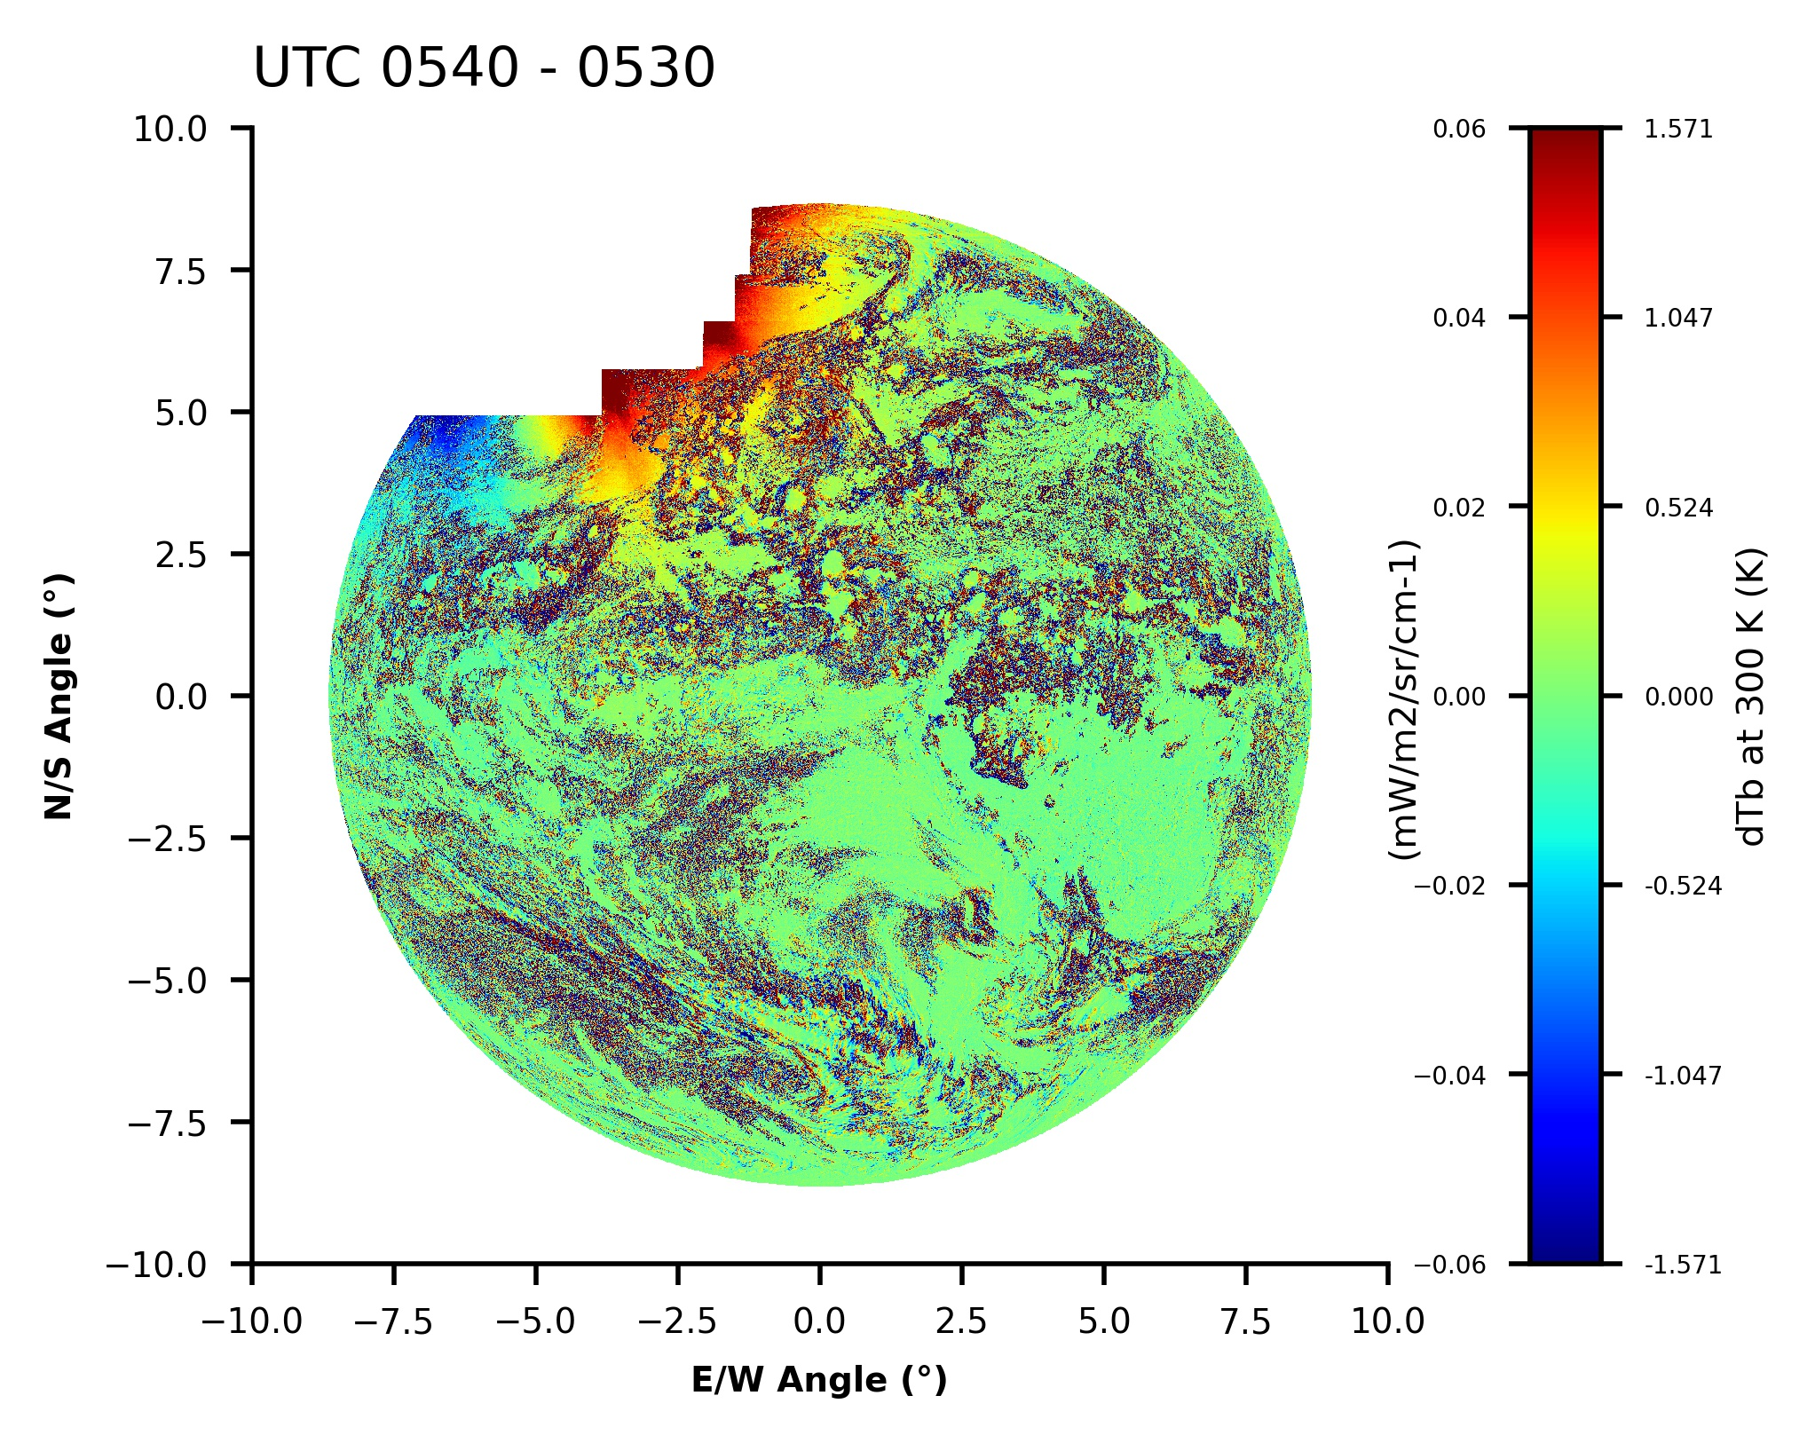
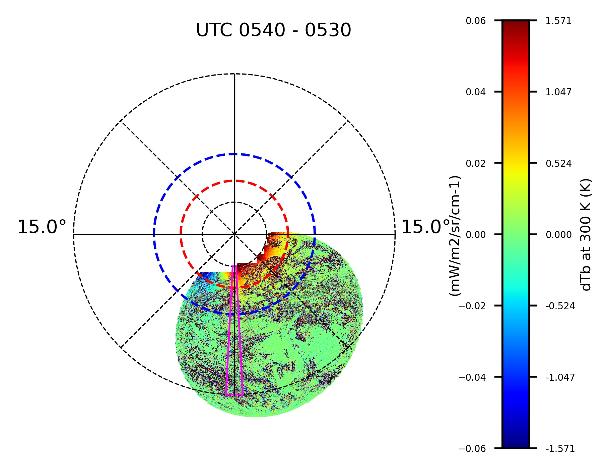
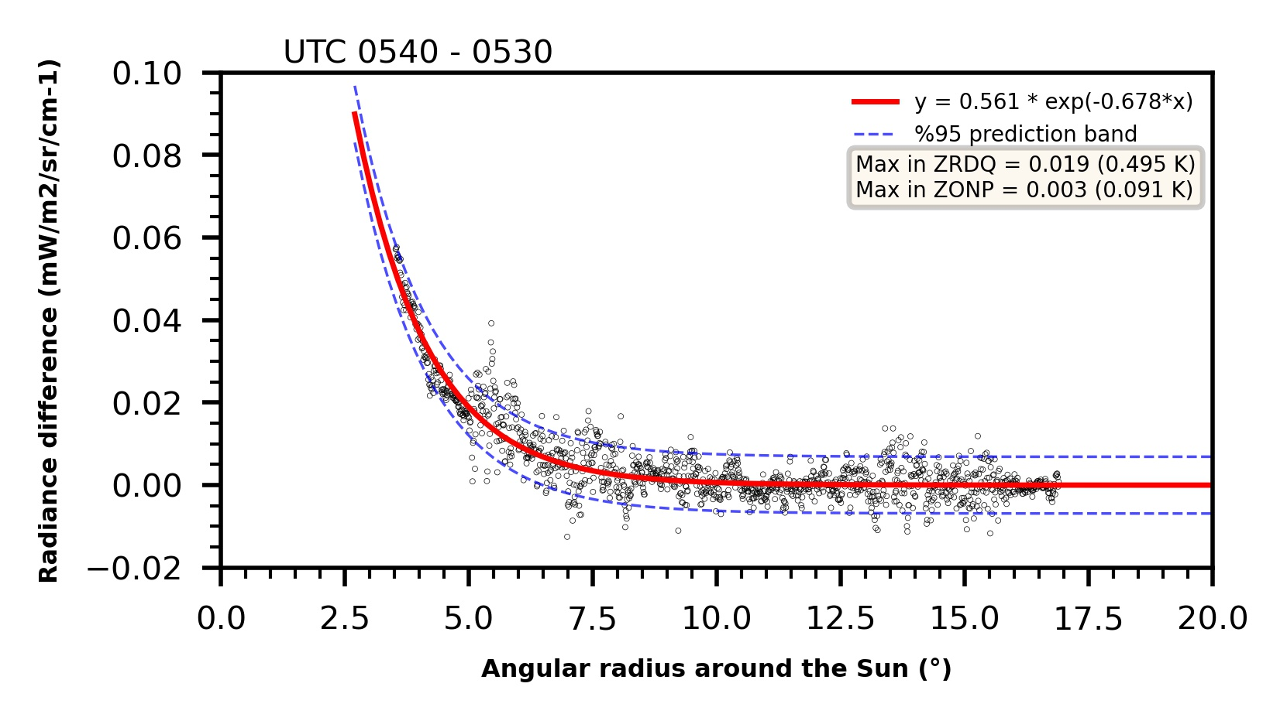
Results with the Sun to the North, …
2024-08-31
Max in ZRDQ = ~0.5K
Max in ZONP = ~0.1K
PLPT-03
Straylight intensity in both ZRDQ and ZONP for GOES-19 CH07 meets the requirements with substantial margins.

Slide 23
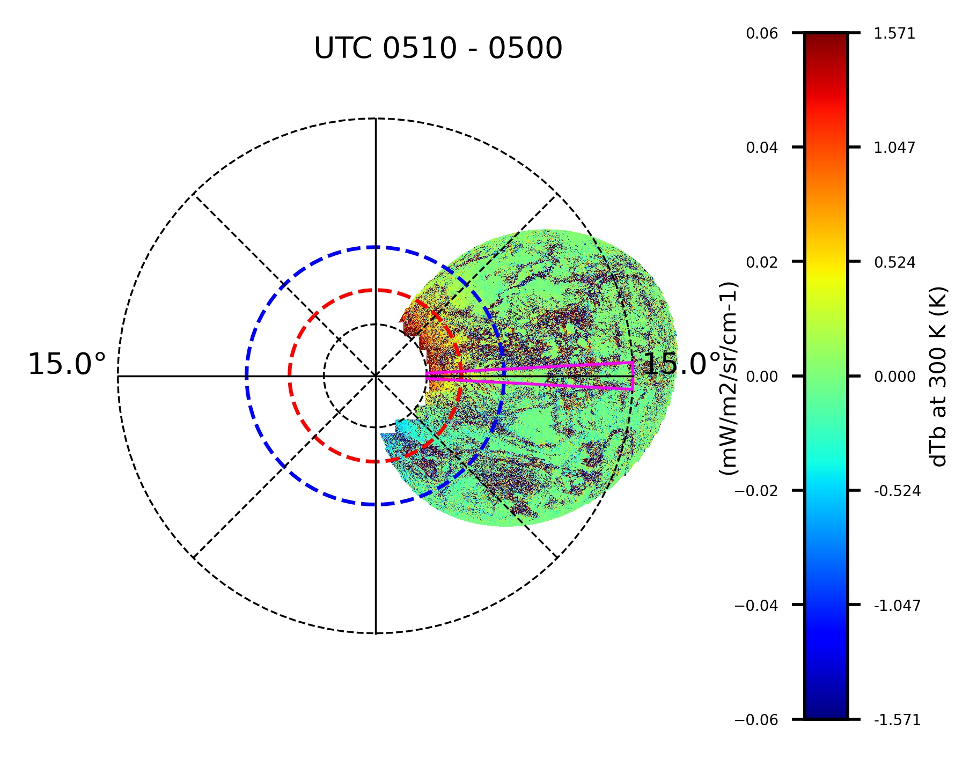
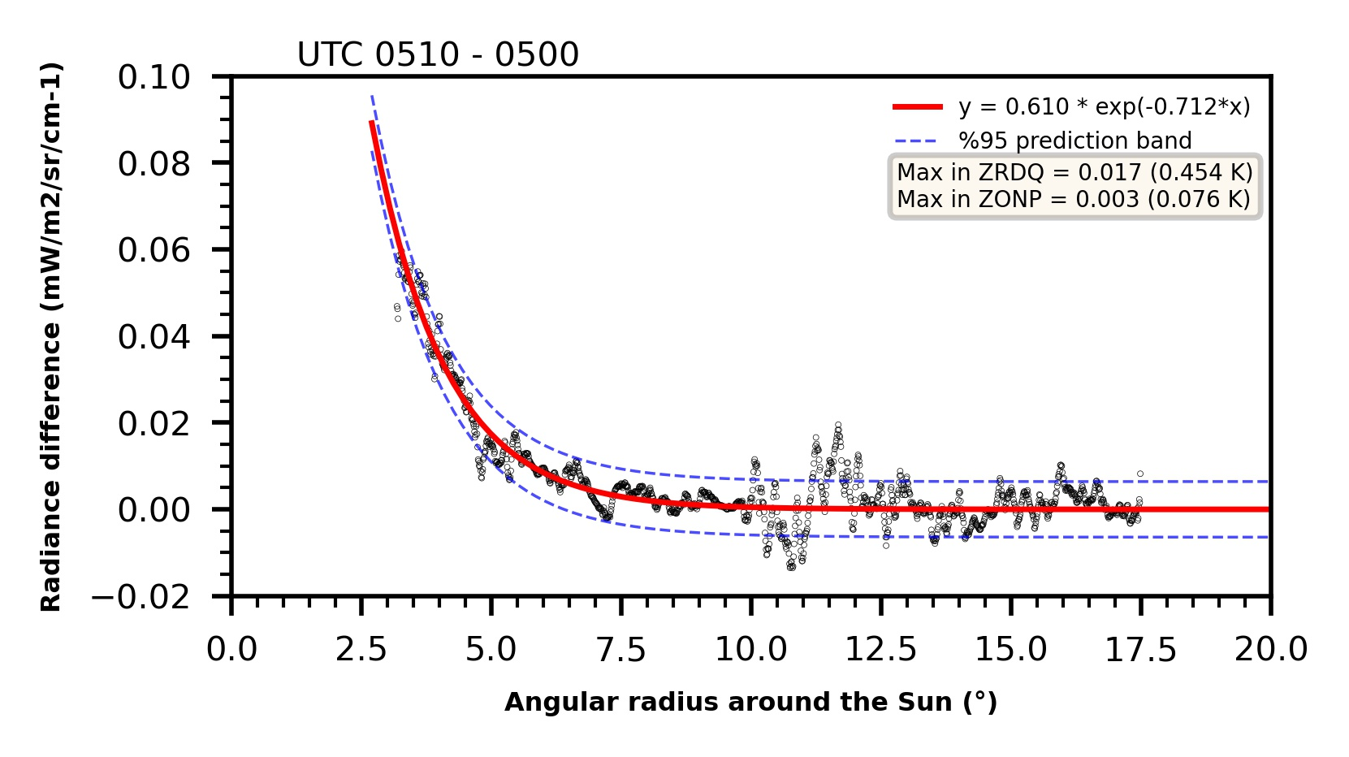
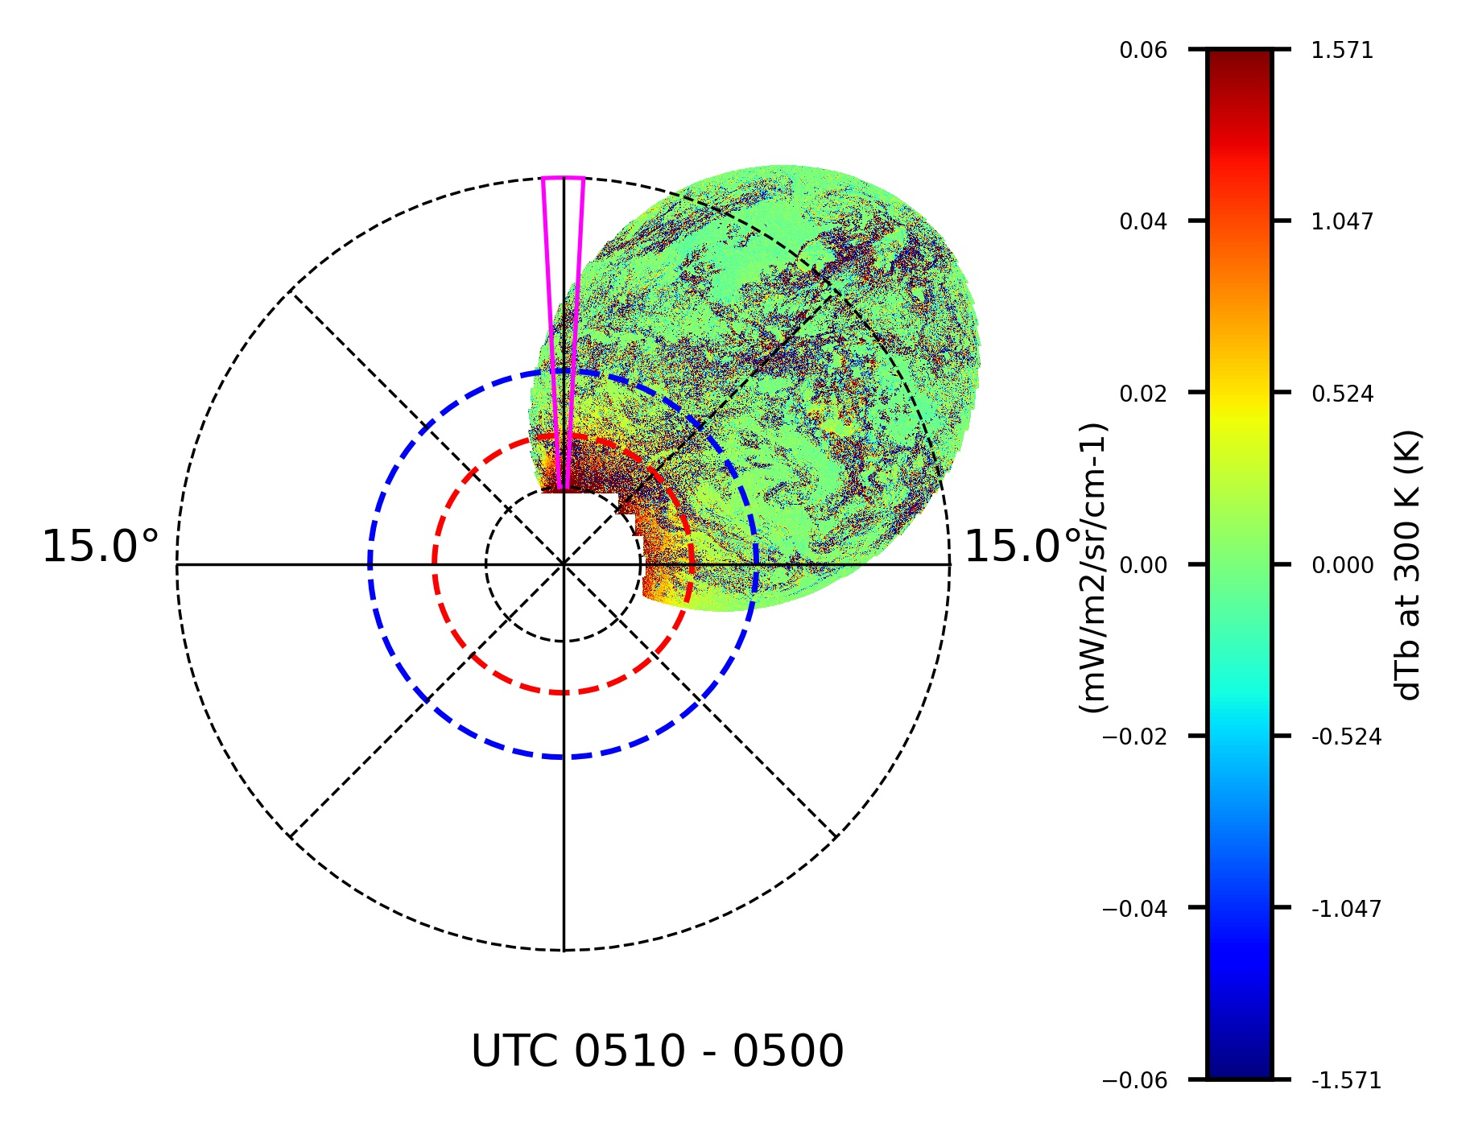
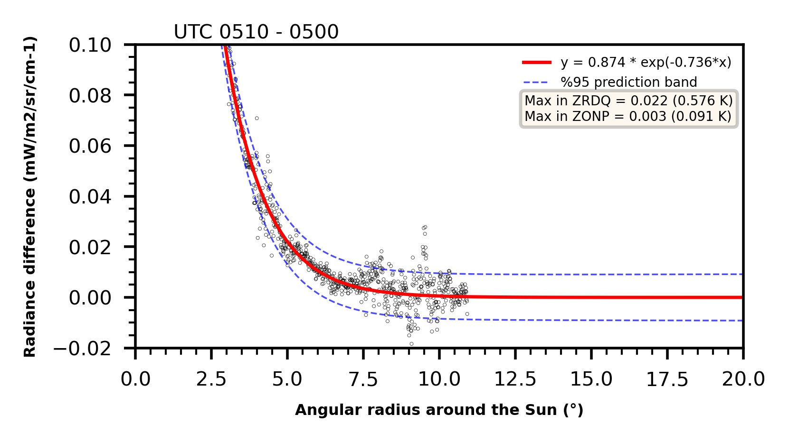
… at the Equator, and to the South
09/22/2024
Max in ZRDQ = ~0.5K
Max in ZONP = ~0.1 K
10/10/2024
Max in ZRDQ = ~0.6K
Max in ZONP = ~0.1 K
PLPT-03
Straylight intensity in both ZRDQ and ZONP for GOES-19 CH07 meets the requirements with substantial margins.

Slide 24
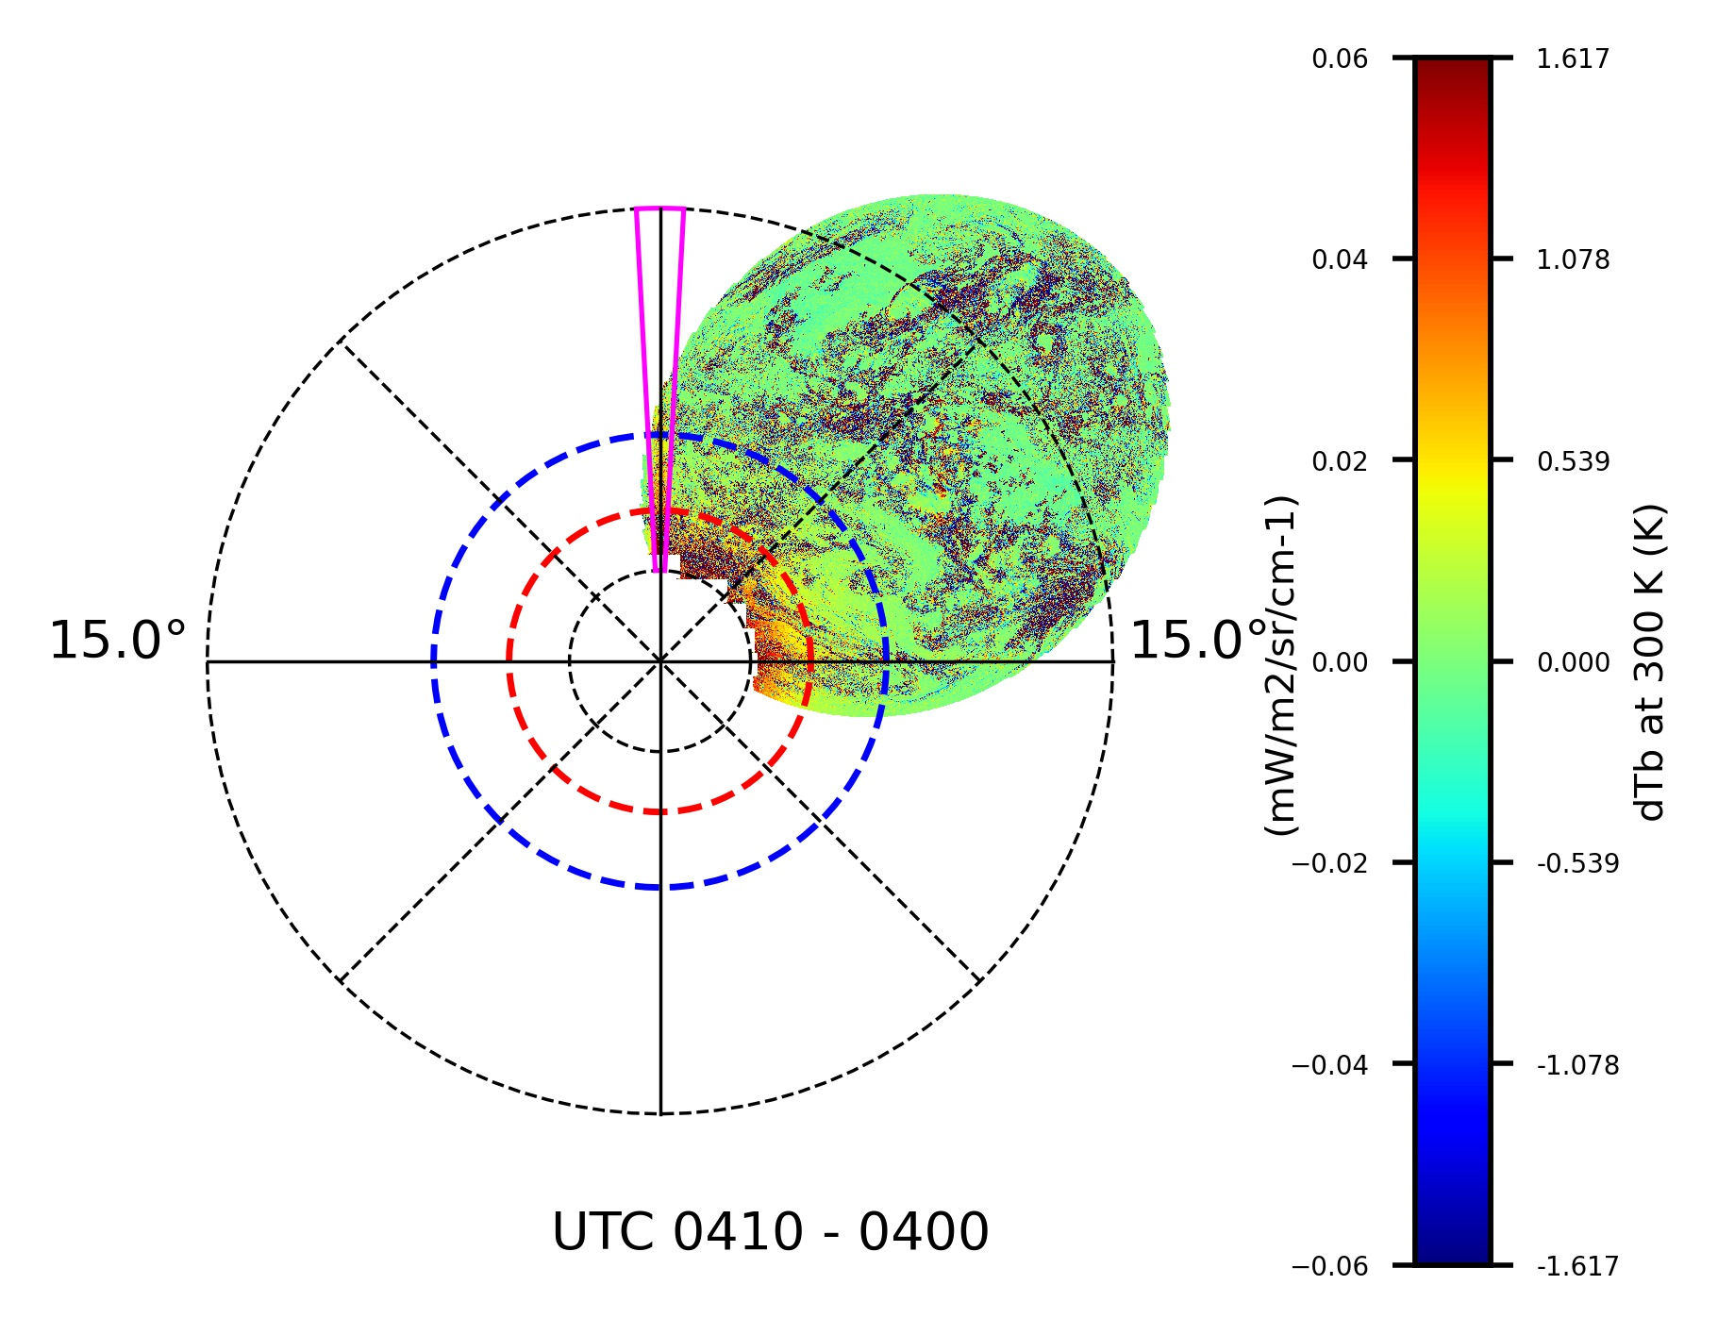
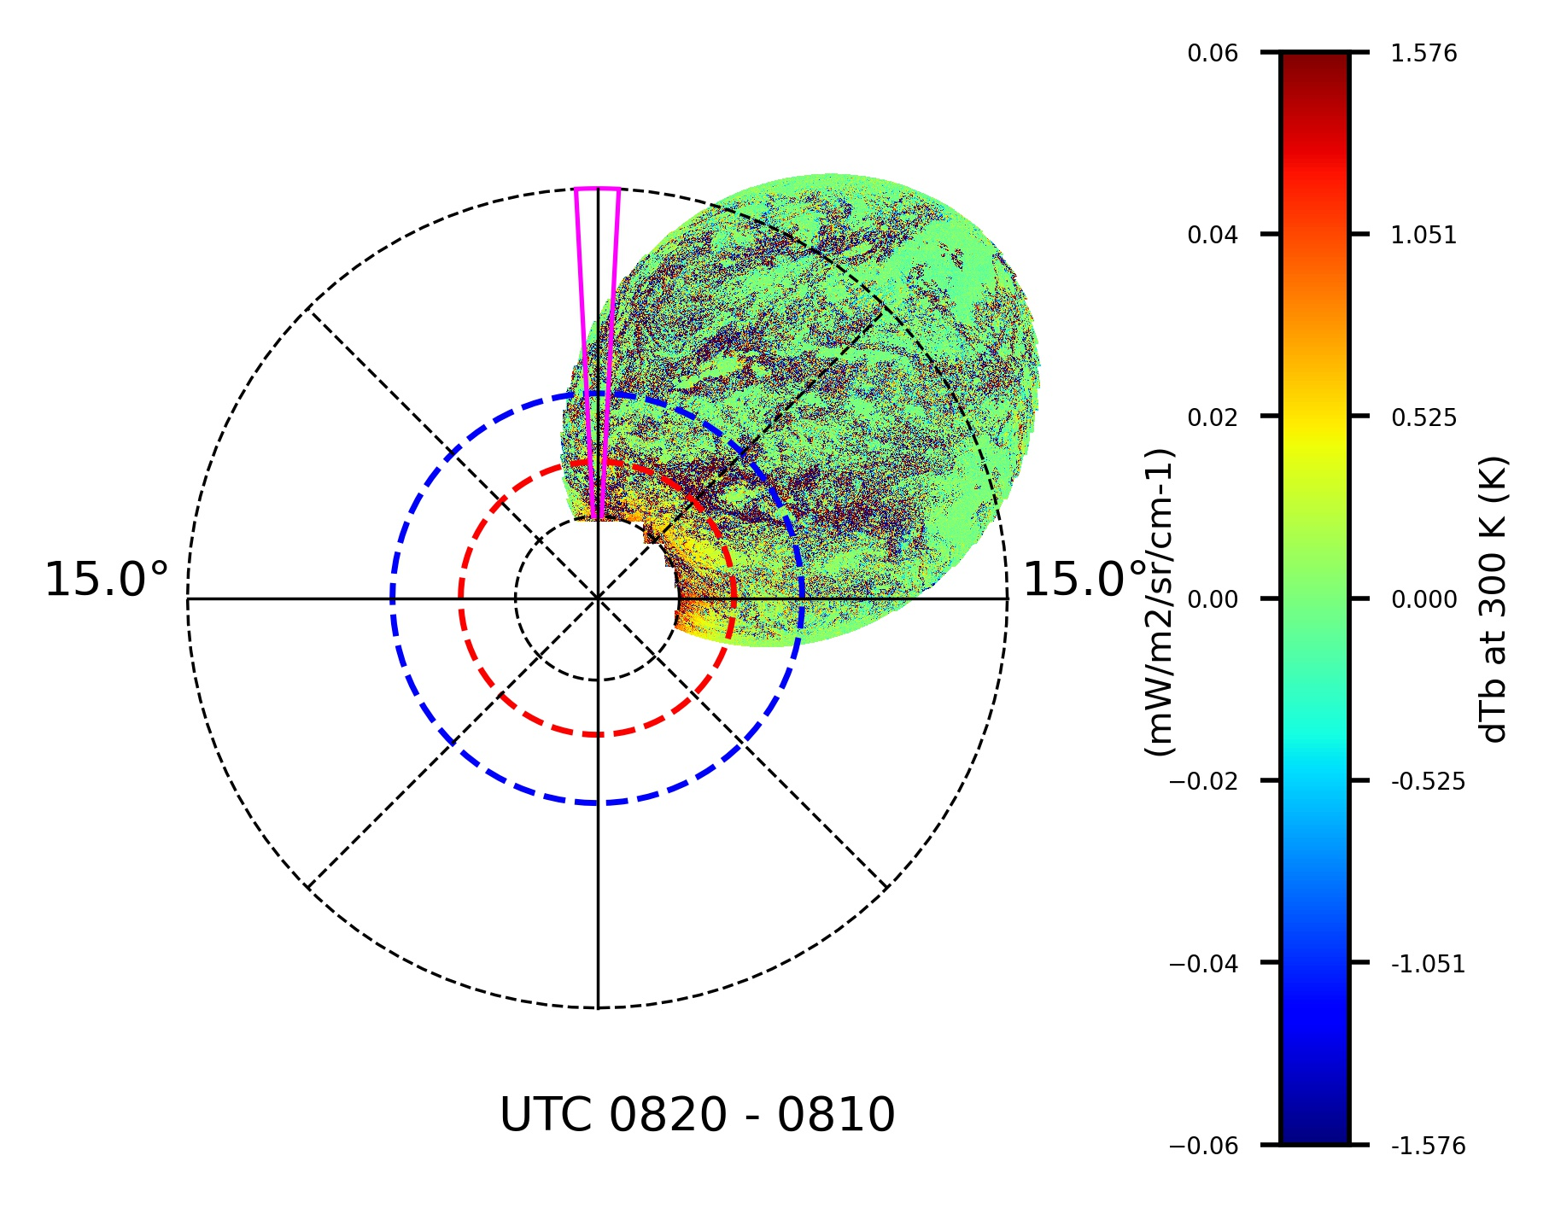
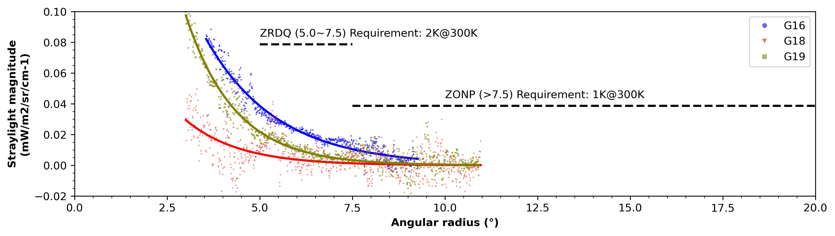
Comparison with GOES-16/18 ABI
10/10/2024
G16
G18
G19
PLPT-03
For G19 ABI, straylight intensity is between those for G16 and G18 ABI.

Slide 25
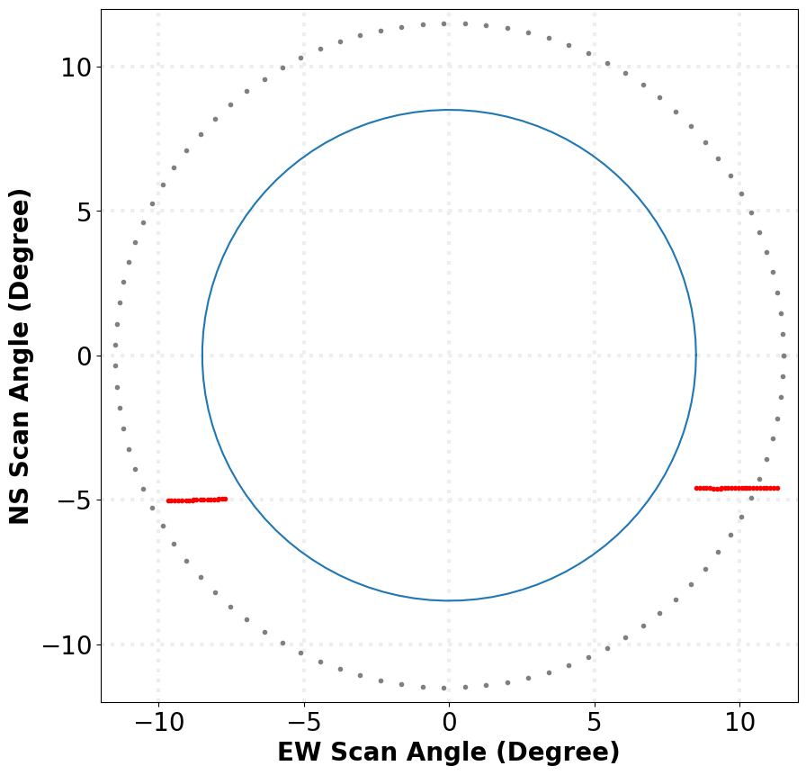

PLPT-06: VNIR Validation – RVS
Verifies spatial uniformity for the solar channels.
Radiance from the Earth are reflected by two scan mirrors to ABI’s sensors at various Angle-Of-Incident (AOI).
Variation of scan mirror reflectance with AOI must be characterized on ground and verified on orbit.
  Larger than acceptable residual error leads to spatially varying (AOI-dependent) calibration errors.
Lacking targets with known radiance, we compare measured and modeled lunar irradiance as the Moon traverses from the west to the east.
These “Moon chasing” data have been partially collected and will be analyzed later.
PLPT-06

Slide 26
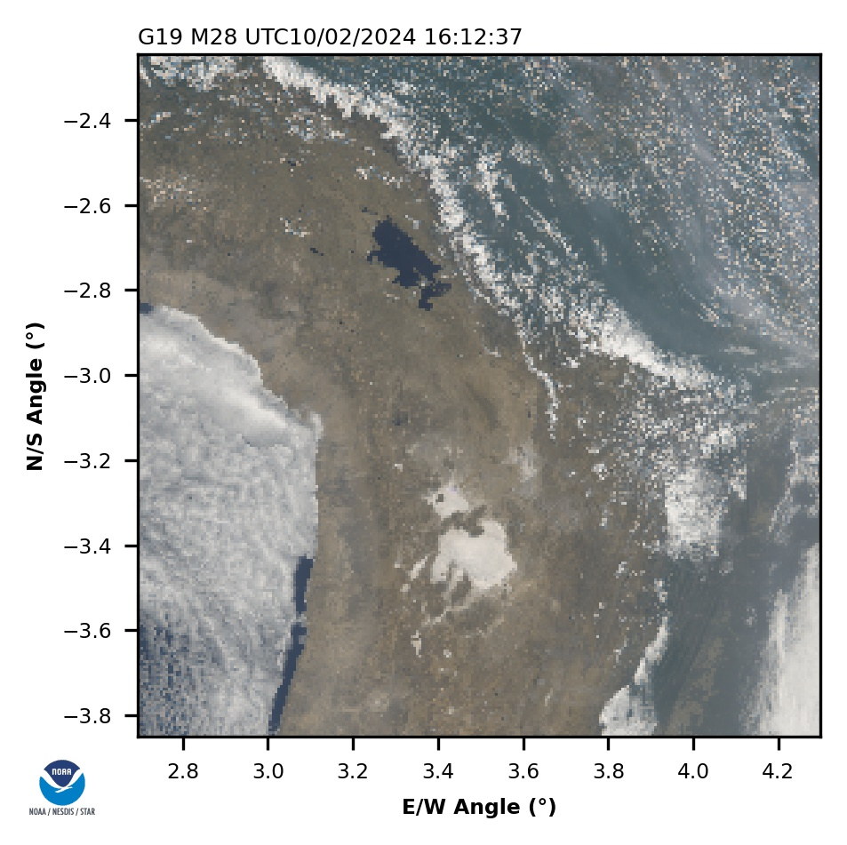
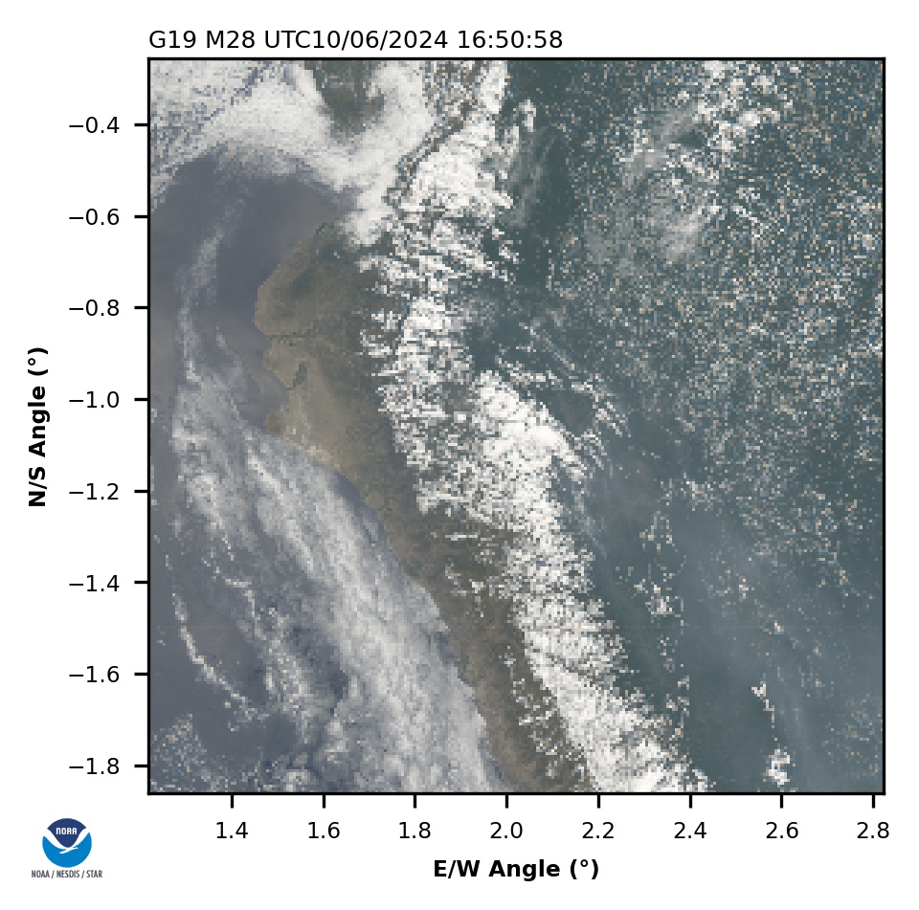
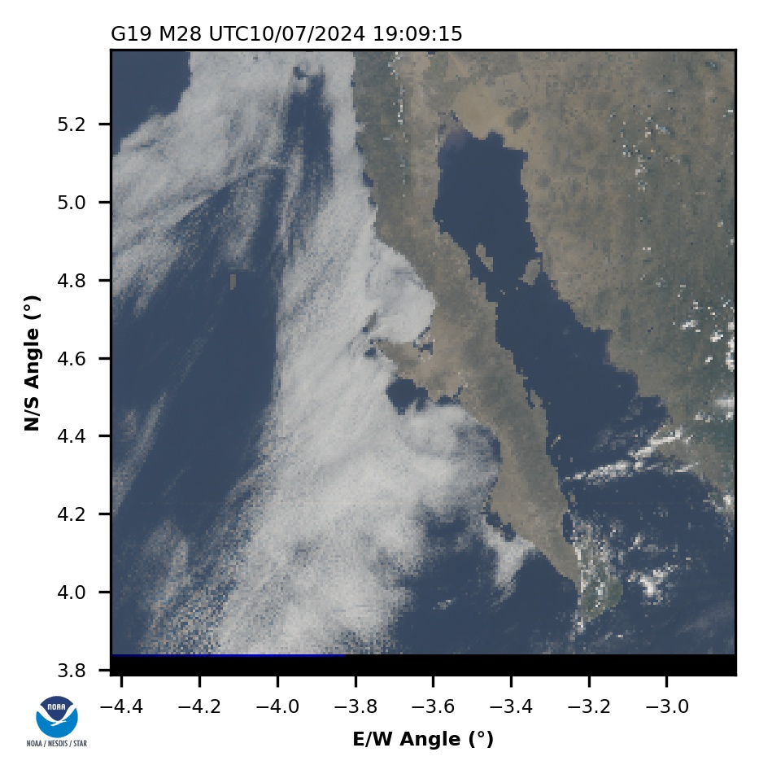
PLPT-09: Low Light SNR
#1 Central Bolivia
#2 Northern Peru
#3 Baja Peninsula
In addition to the SNR requirement that applies to bright (100% albedo) target, ABI Channel 2 (640 nm) is also required to have SNR of 20 or more for target of 5% albedo or brighter.
Special data for this test have been collected and processed into L1b using GRATDAT.
Above are examples of data collected over three targets.
PLPT-09

Slide 27
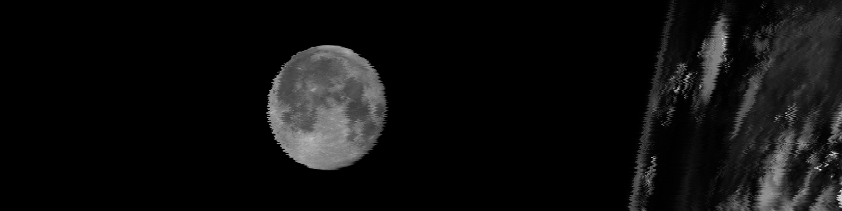
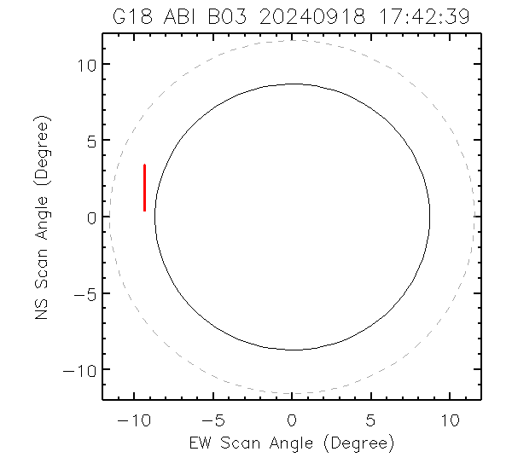

PLPT-17: Detector Uniformity
Verify ABI detector response uniformity for each channel
  ABI detector-to-detector relative calibration accuracy shall be within derived NEdN (MRD519)
Special North-South-Scan (NSS) over the lunar surface are conducted when the Moon at specific phase angle appears in the space within the ABI field of regard
Most of the events have been collected and processed into L1β data using GRATDAT. Test will continue.
Table: Lunar NSS data collection time and the phase angles
No. | Collection Date | Lunar Phase Angle (Degrees)
1 | 9/18/2024 | +7º – +11º
2 | 10/15/2024 | -24º – -27º
3 | 11/25/2024 | +110º – +113º
4 | 12/08/2024 | -90º – -93º
5 | 12/09/2024 | -77º - -79º
6 | 01/05/2025 | ~-110º
Fig. 1. The Moon appeared in the space left to the Earth on 09/18/2024
PLPT-17
Fig. 3. Light Of Sight (LOS) trajectory corresponding to the NSS scan shown in Fig 2.
Fig. 2. Example of lunar NSS images showing all detectors from one channel across the lunar surface

Slide 28
PLPT-19: Initial Solar Channel Calibration
Establish post-launch calibration baseline at the BOL, in reference to pre-launch calibration.
Selected the ten solar calibration data 8/31 – 9/18, in consideration of:
  Minimal degradation of solar diffuser;
  Large number of measurements (high frequency of calibration) to reduce error; and
  Stable solar elevation angle at the time of calibration.
All variations are reasonable.
  Pre-launch calibration of the 1.38 µm channel was subject to water vapor contamination.
Adjusted the 0.64 µm channel gain via K-LUT anyway to be consistent with previous ABIs.
FM | GOES-16 | GOES-17 | GOES-18 | GOES-19
Gain Reduction | 6.2% | 6.9% | 3.4% | 2.7%
PLPT-19

Slide 29
PLPT-32/36: Dynamic Range & QSS
Verified that all GOES-19 Channels are capable of covering the required dynamic range with adequate step size.

Slide 30
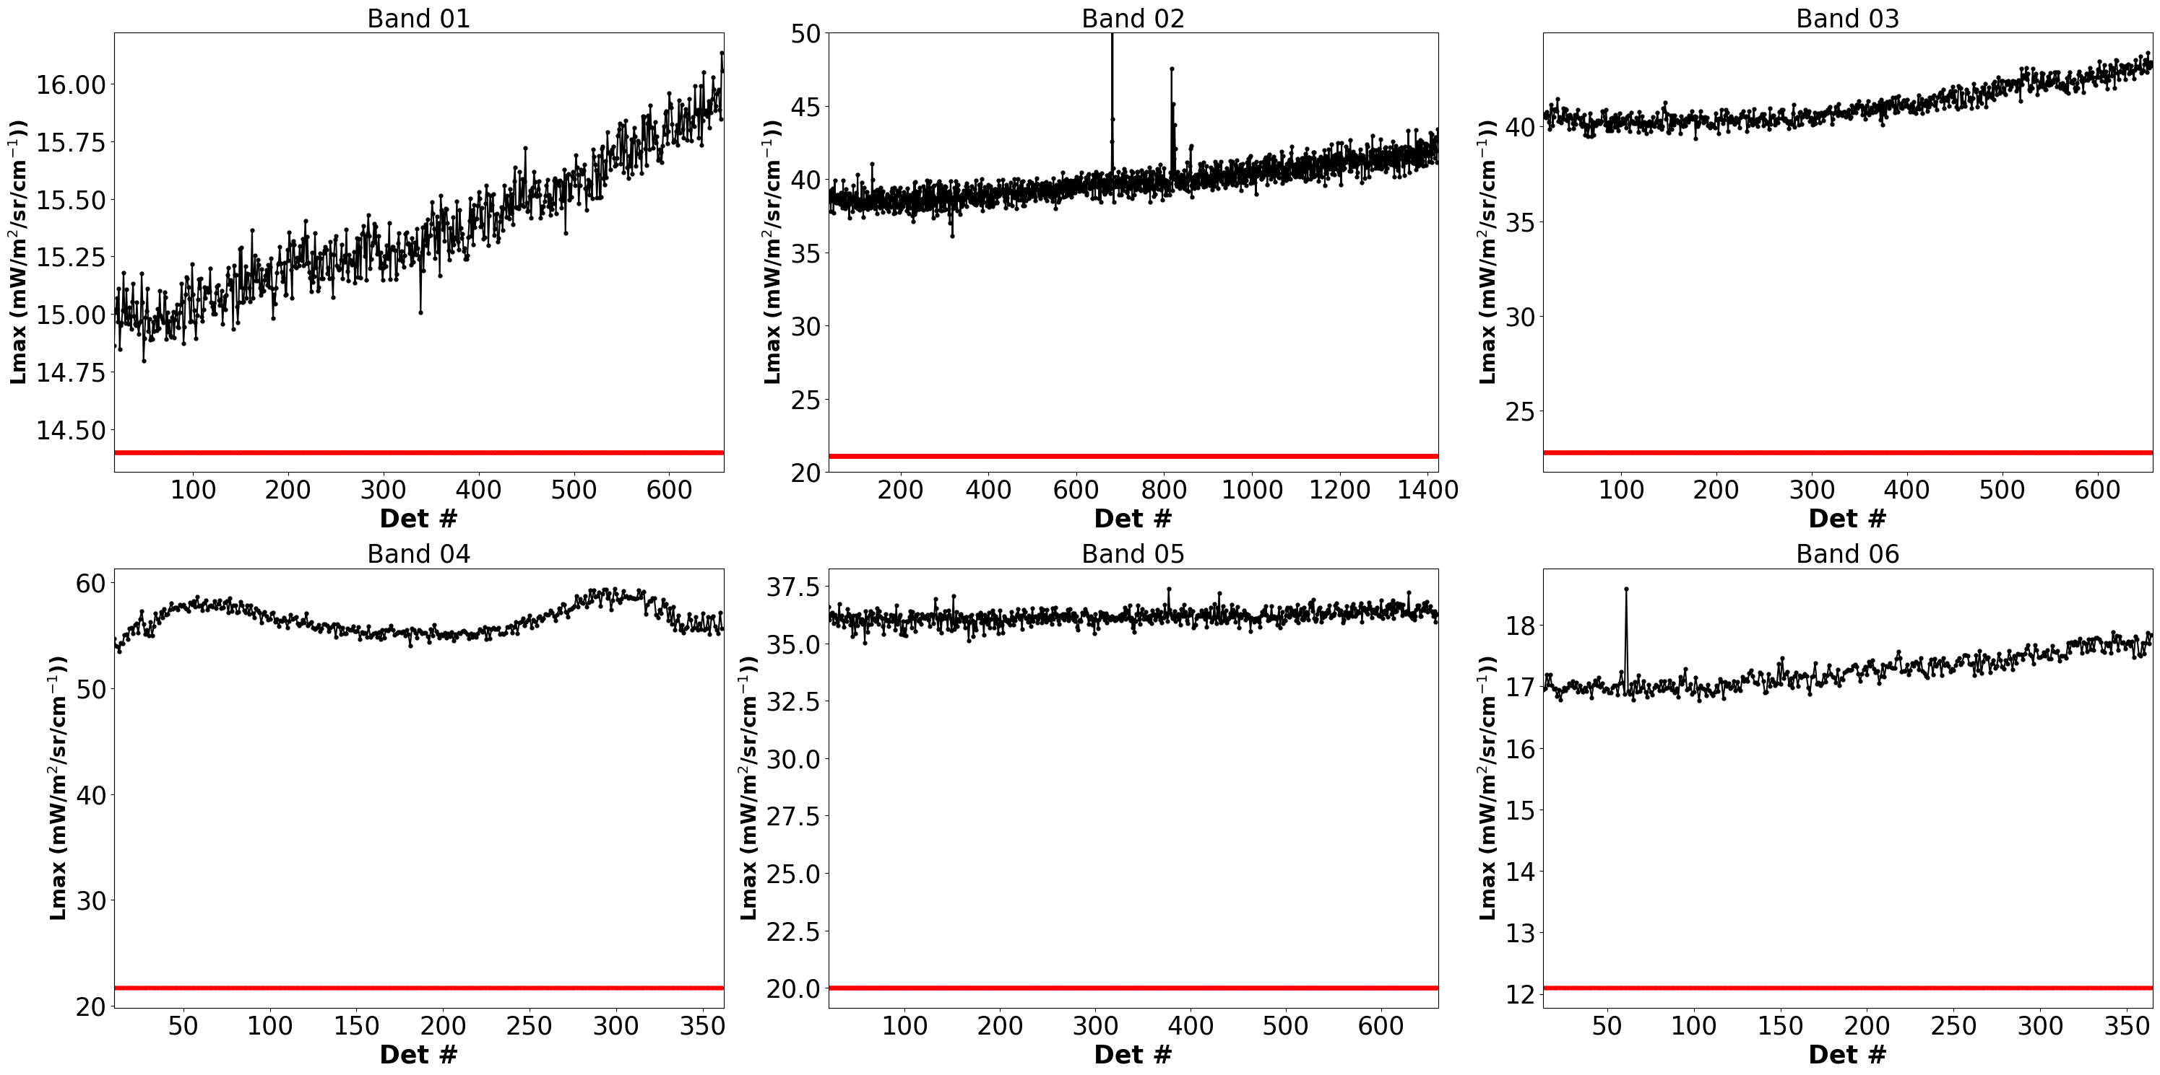
GOES-19 ABI Solar Channel L_{max}
PLPT-32/04
All channels have adequate margin for the dynamic range requirement.

Slide 31
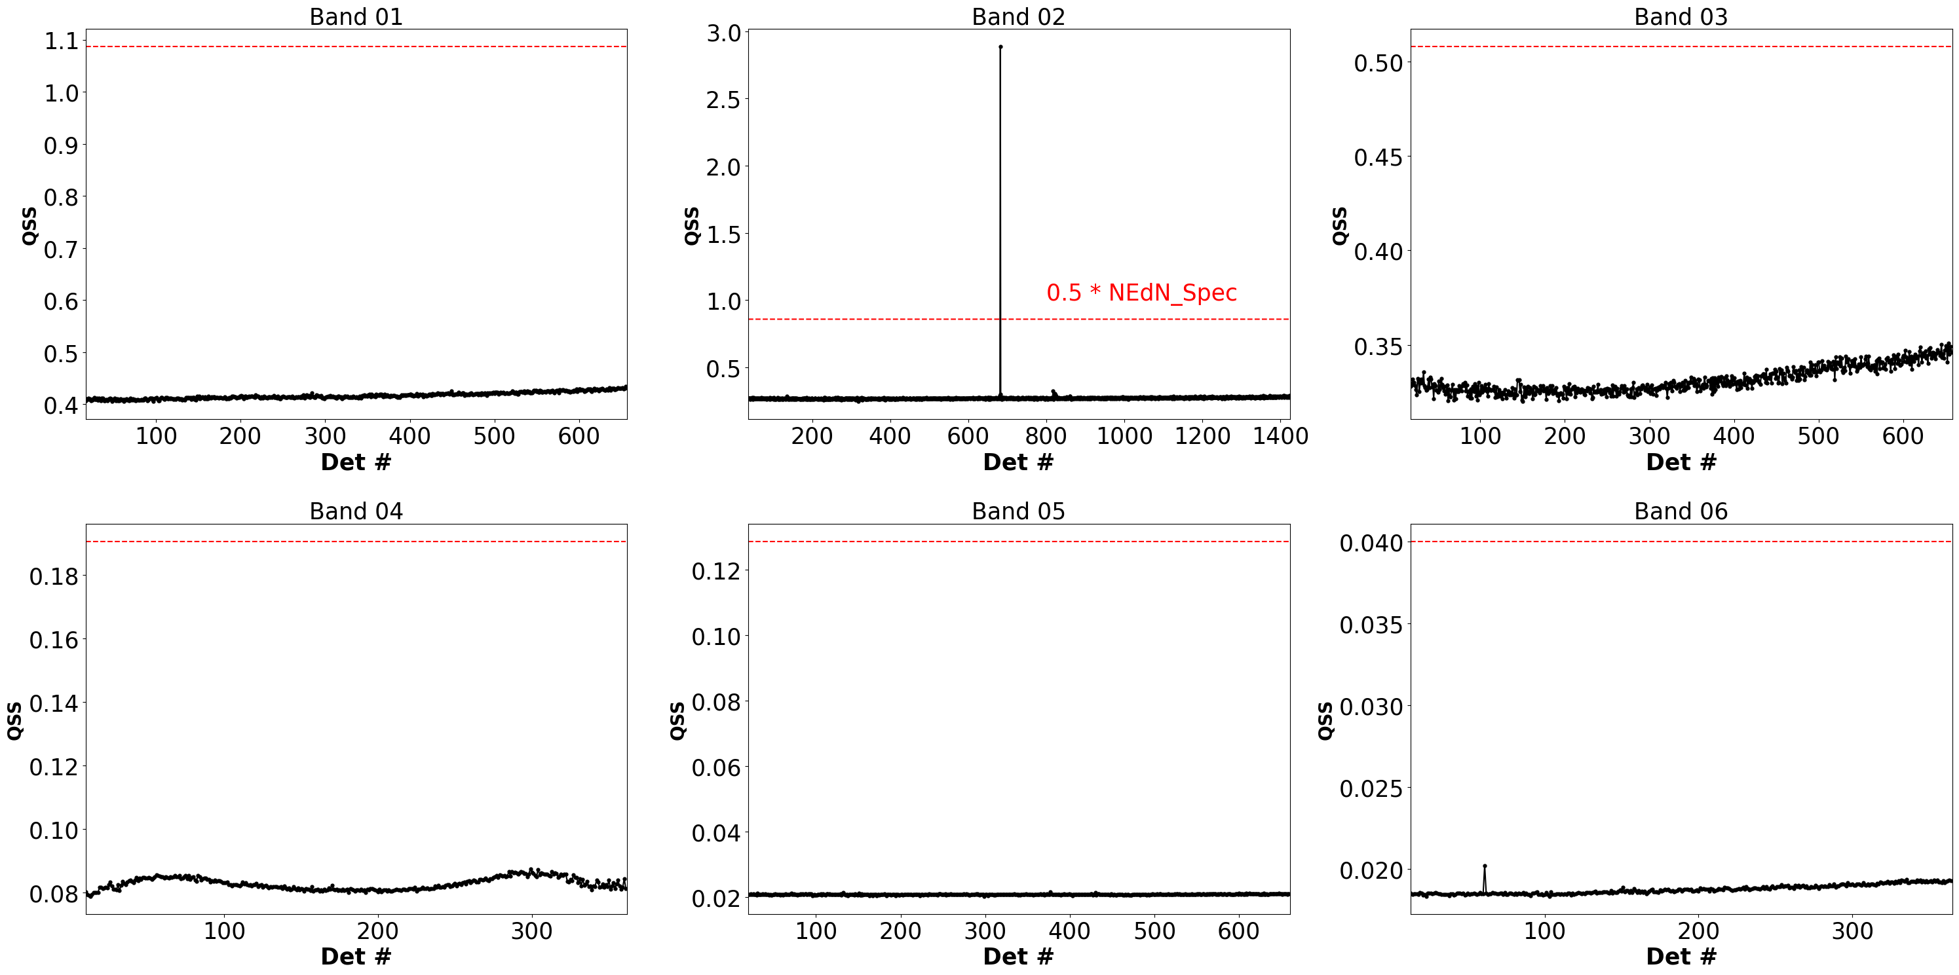
GOES-19 Solar Channel Quantization Step Size
PLPT-32/04
Except for D682 of B02, all channels have adequate margin for the QSS requirement.

Slide 32
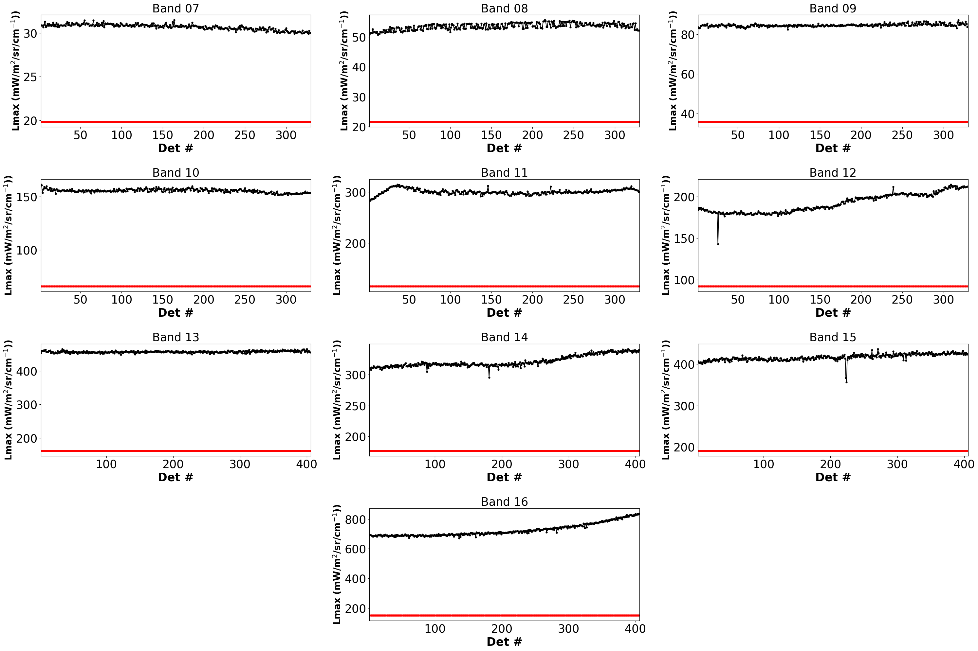
GOES-19 ABI IR Channel L_{max}
All channels have adequate margin for the dynamic range requirement.
PLPT-36/01

Slide 33
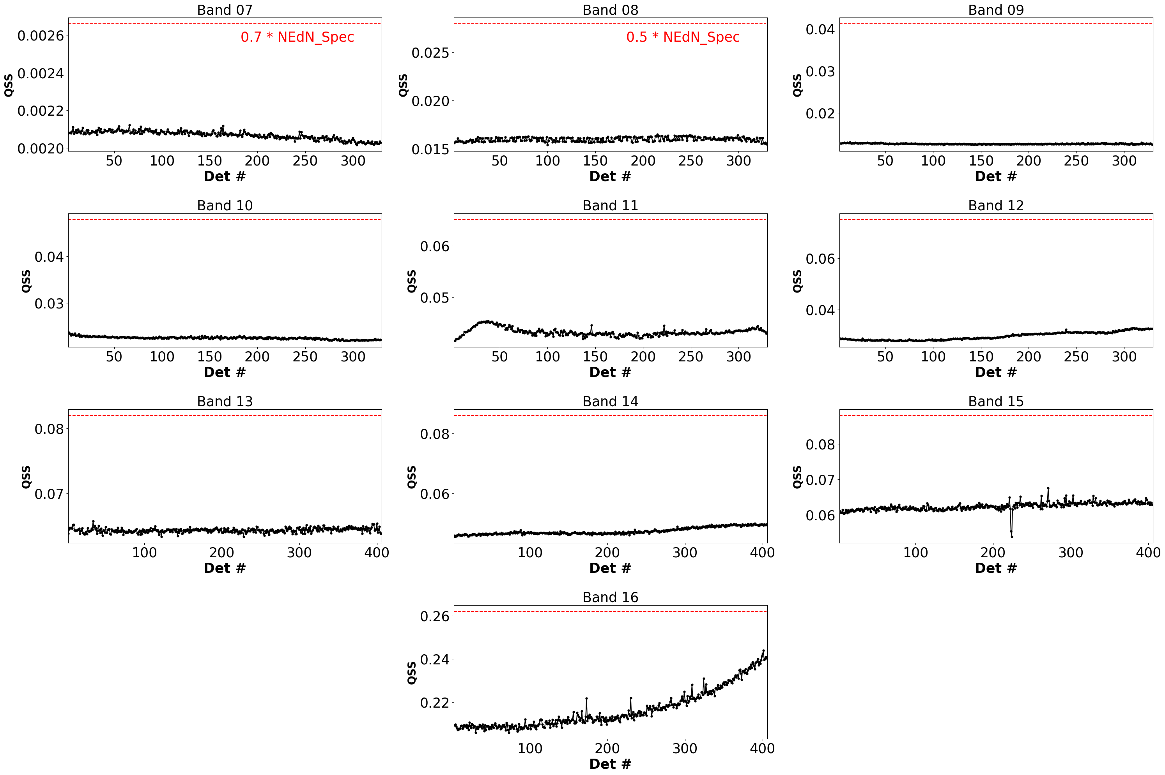
G19 IR Channel Quantization Step Size (QSS)
All G19 IR bands meet the QSS requirements.
PLPT-36/01

Slide 34
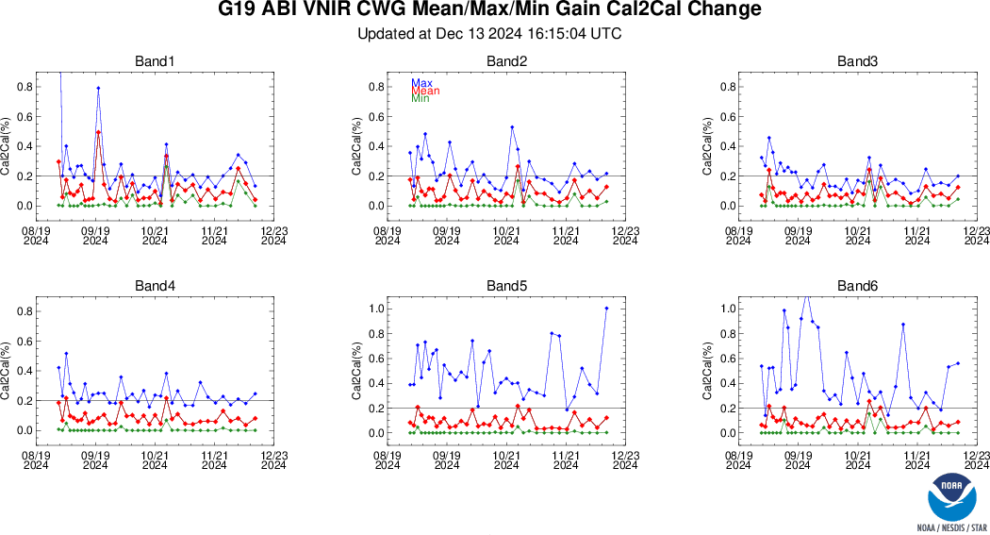
PLPT-24 Cal Repeatability: VNIR Cal-to-Cal
PLPT-24/04
All channels exceed the requirement sometimes at the actual cadence (ADR 1516).

Slide 35
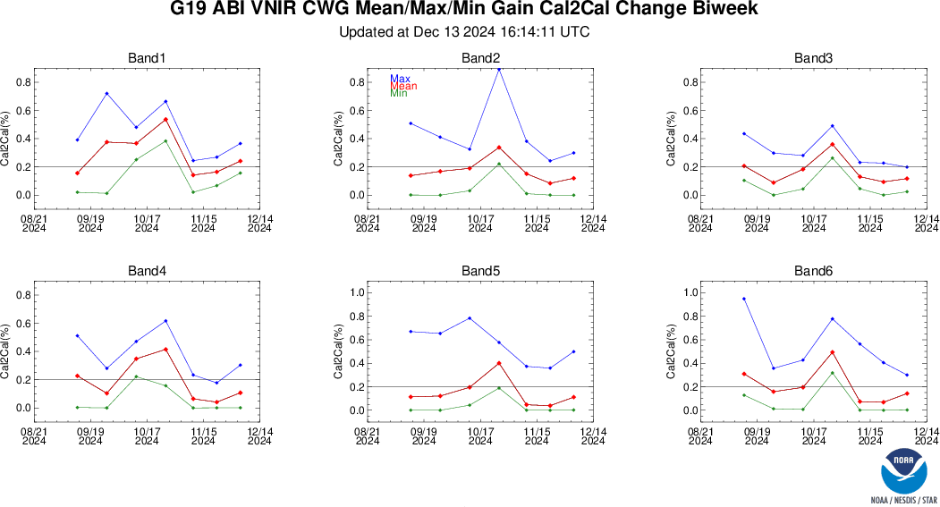
PLPT-24 Cal Repeatability: VNIR Cal-to-Cal
PLPT-24/04
All channels exceed the requirement most times at the operational cadence (ADR 1516).

Slide 36
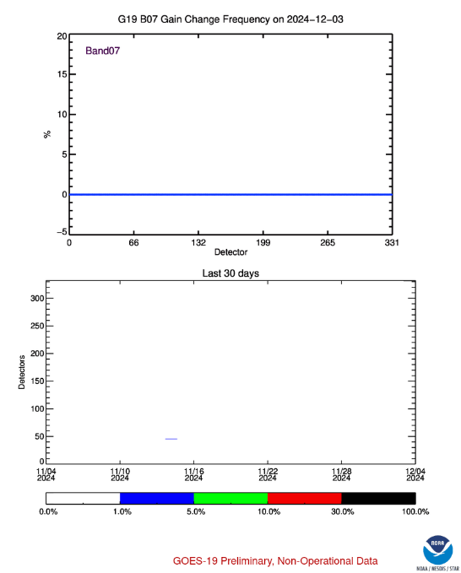

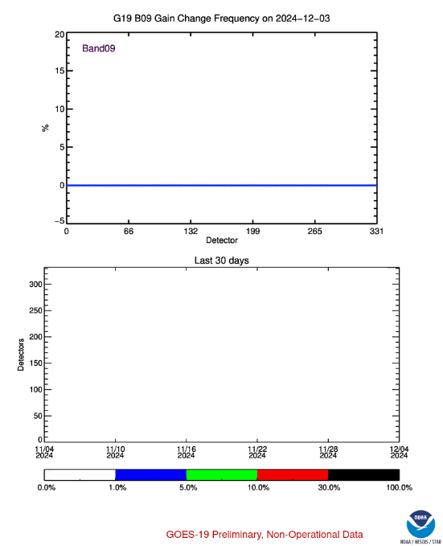


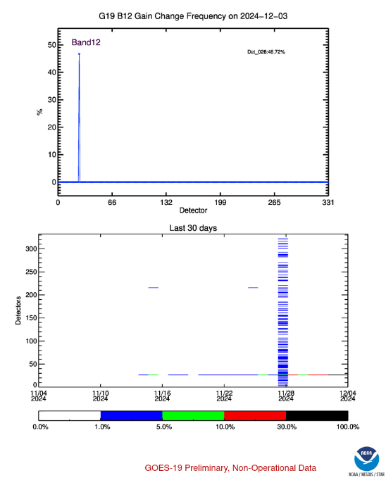
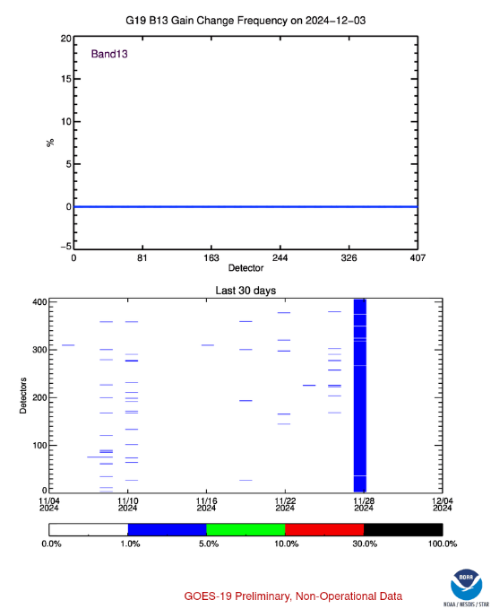
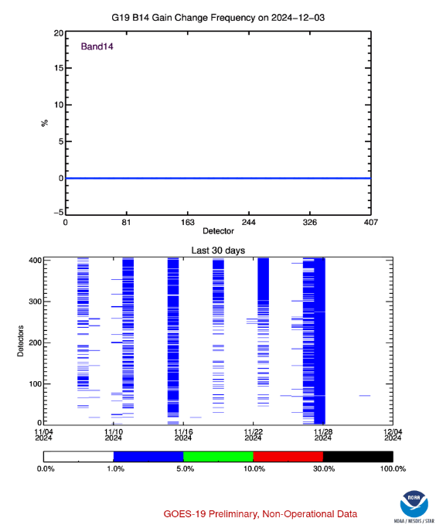
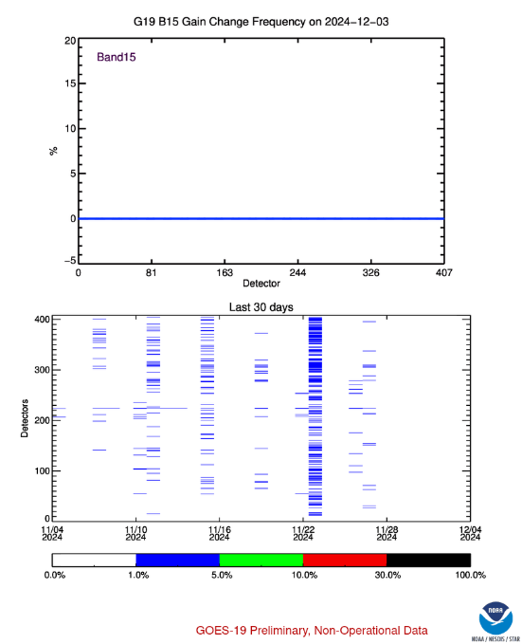
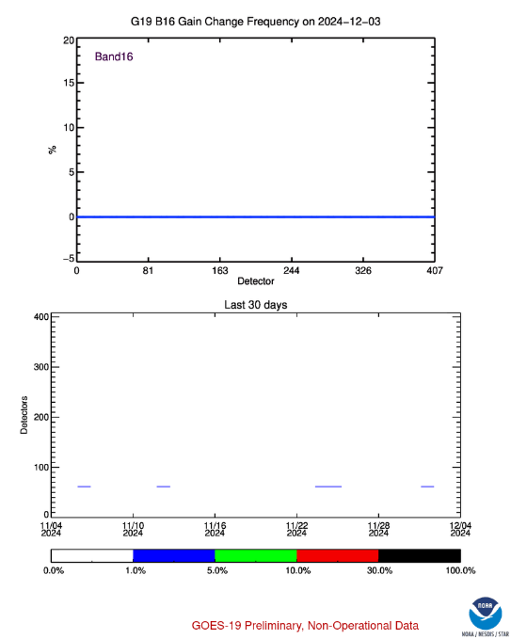
PLPT-24 Cal Repeatability: IR Cal-to-Cal
Frequencies of gain changes between two calibrations, for every channel and detector in a day from 11/4 to 12/4, that exceed the requirement.
None for the MWIR channels (7-11, upper row).
Some for the LWIR channels (12-16, lower row), often at local noon and midnight when the space look shifts side.
  That ended after 11/27 when incorrect scan mirror emissivity was updated.
One exception is the unstable detector on Row 26 of B12, which is being replaced.
PLPT-24/01

Slide 37
PLPT-34: MTF (Preliminary)
 | Band | GOES-19 Prov
 | (µm) | 1/4 Nyq | 1/2 Nyq | 3/4 Nyq | Nyquist
EW, Rising | 0.47 | 0.92 | 0.76 | 0.55 | 0.38
EW, Rising | 0.64 | 0.91 | 0.72 | 0.51 | 0.33
EW, Rising | 0.86 | 0.92 | 0.73 | 0.52 | 0.34
EW, Rising | 1.38 | 0.94 | 0.81 | 0.63 | 0.47
EW, Rising | 1.61 | 0.89 | 0.67 | 0.44 | 0.26
EW, Rising | 2.25 | 0.94 | 0.80 | 0.62 | 0.45
 | MRD | 0.90 | 0.73 | 0.53 | 0.32
PLPT-34
EW, Falling Results note: Sharp EW Falling datasets is still to be collected.

Slide 38
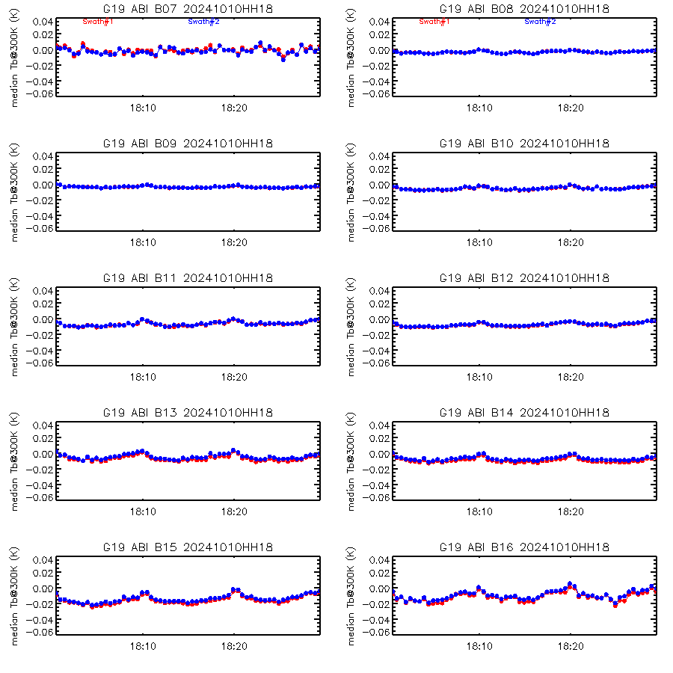
PLPT-40/41: Spatial Uniformity
Verifies spatial uniformity for the IR channels.
Radiance are reflected by two scan mirrors to ABI’s sensors at various Angle-Of-Incident (AOI), together with the scan mirrors’ emission.
Scan mirror emissivity and reflectance vary with AOI, which must be characterized on ground and verified on orbit.
  Larger than acceptable residual error leads to spatially varying (AOI-dependent) calibration errors.
For IR channels, space is an ideal targets with known (zero) radiance. Through “space NSS” and “space chasing”, this test quantifies residual error of scan mirror emissivity with AOI.
Most of data have been collected. Test will continue.
Time-series of normalized space MESO radiance for the 10 IR bands collected on 10/10/2024, demonstrating variations well within the derived NEdN requirement.
PLPT-40/41

Slide 39
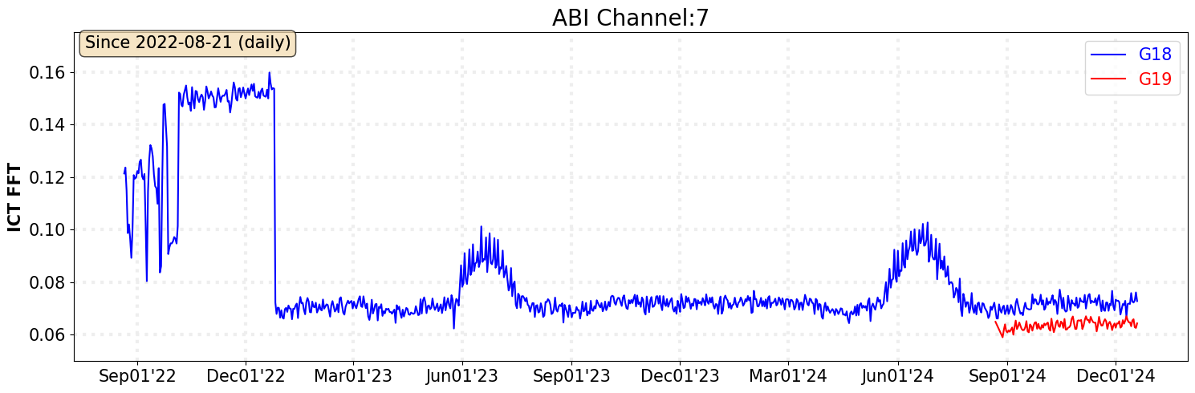
PLPT-43: Barcode Artifact
PLPT-43
No BA in GOES-19, either from users’ feedback or quantitative monitoring.

Slide 40
issues

Slide 41
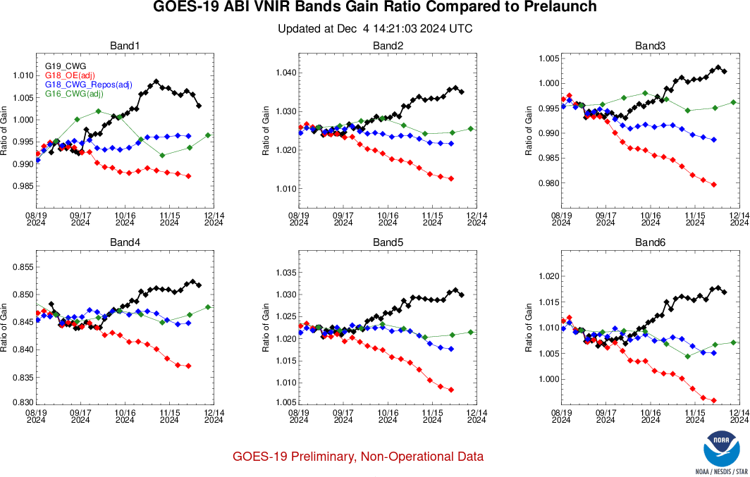
1) Unexplained Trend for Solar Channel Gain
An unexplained trend was found for all GOES-19 ABI solar channels (black).
Similar to GOES-18, though in the opposite direction (red), until it corrected for an alignment error (blue).

Slide 42
PLPT-24 Cal Repeatability: VNIR Cal-to-Cal
PLPT-24/04
All channels exceed the requirement most times at the operational cadence (ADR 1516).

Slide 43
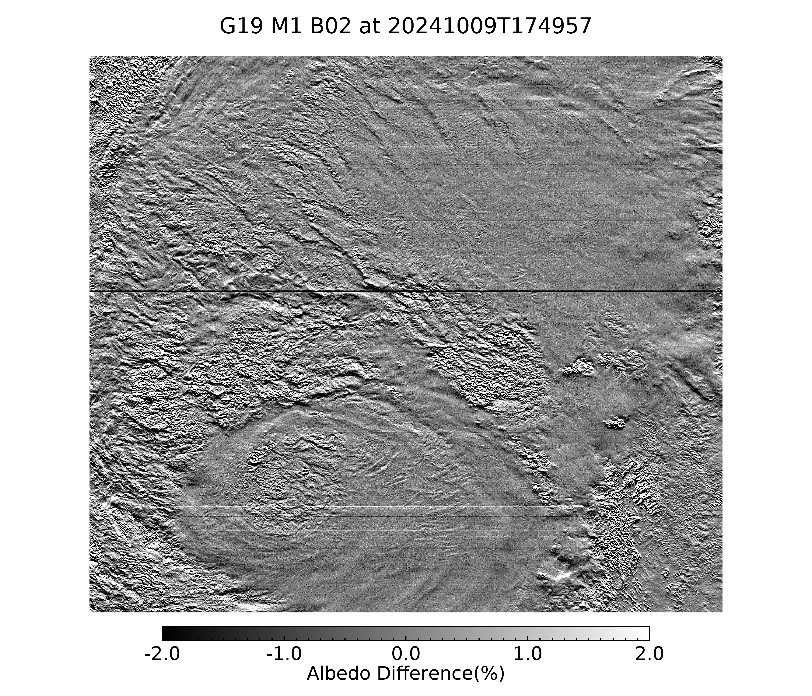
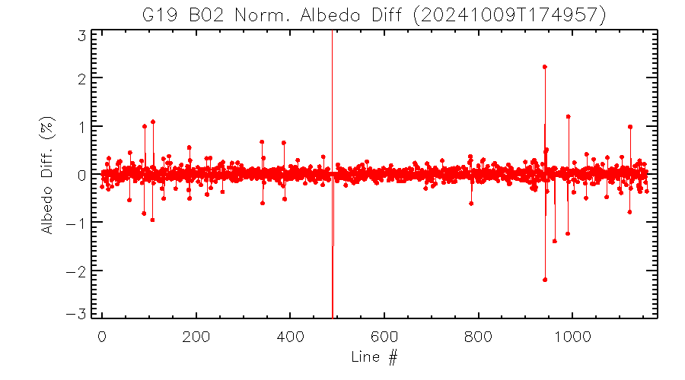
2) Bad Detector on Row 682 of B02
Det#682
N → S
stitch line
Results in striping.
Two of the three detectors are confirmed bad. Quality of the last one is uncertain.
The backup plan (“Dead Row List”) does not work well.

Slide 44
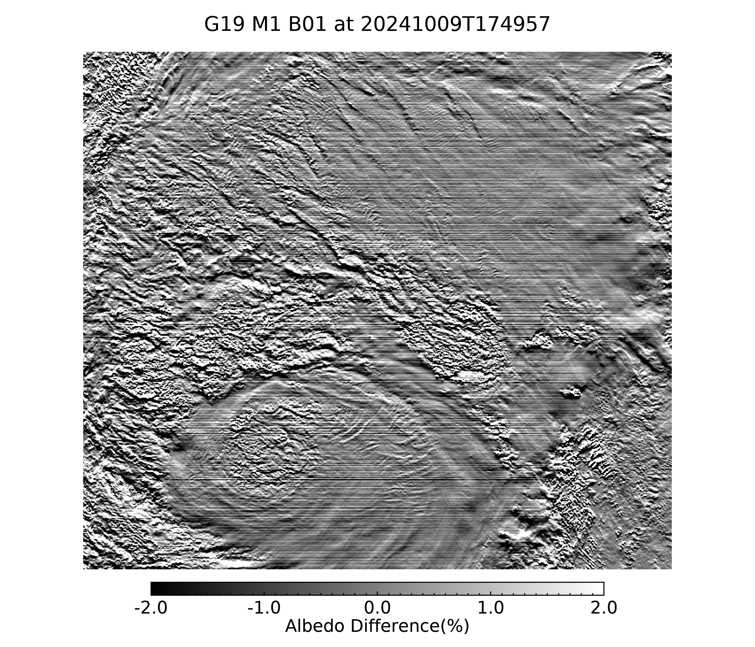
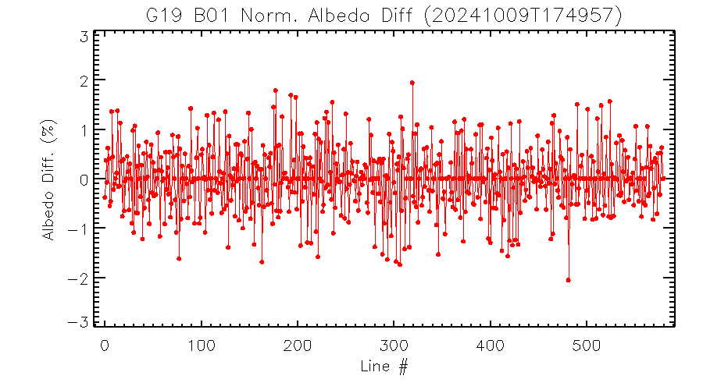
3) Multiple Weak Stripping in B01
N → S
Worse striping than other channels & FMs.

Slide 45
Band 2
Det#682
N → S
stitch line
Need further study
Visually apparent striping associated with noisy detector #682.
One line (detector) show >2% of norm. albedo difference from its neighbor. Need further study.
Otherwise, only couple lines may marginally exceeds 1% of normalized albedo difference from neighbor lines

Slide 46
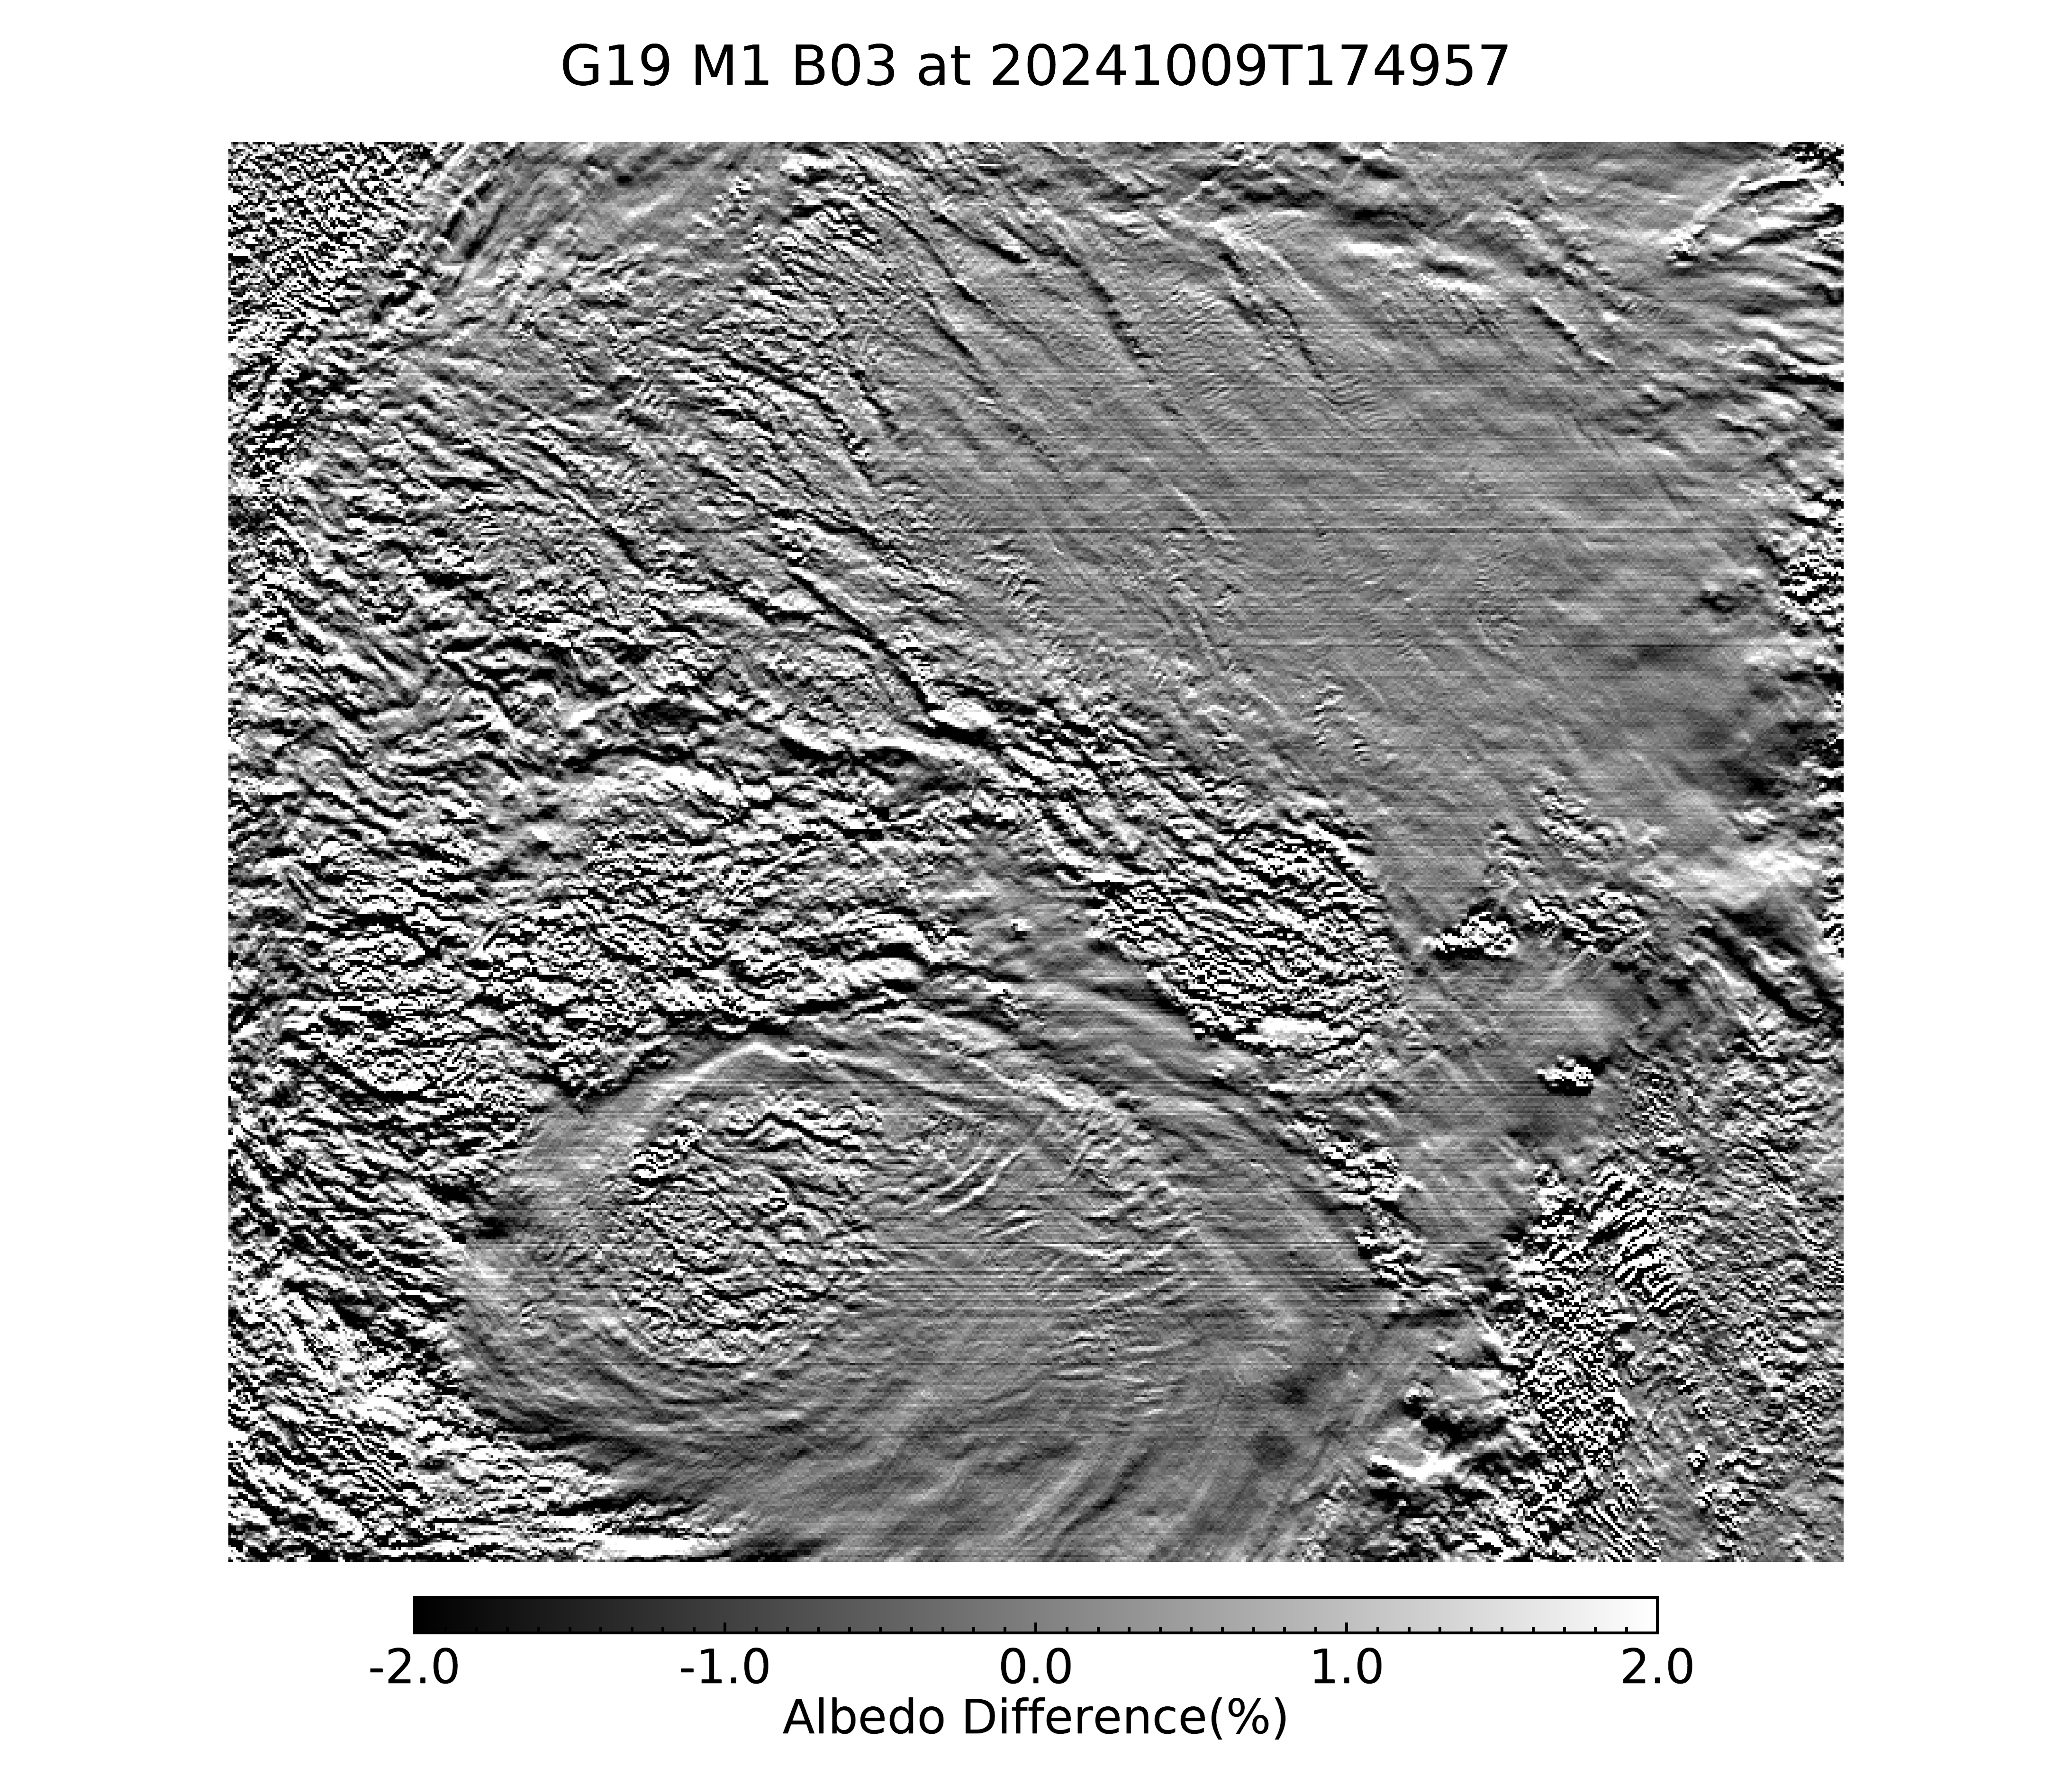
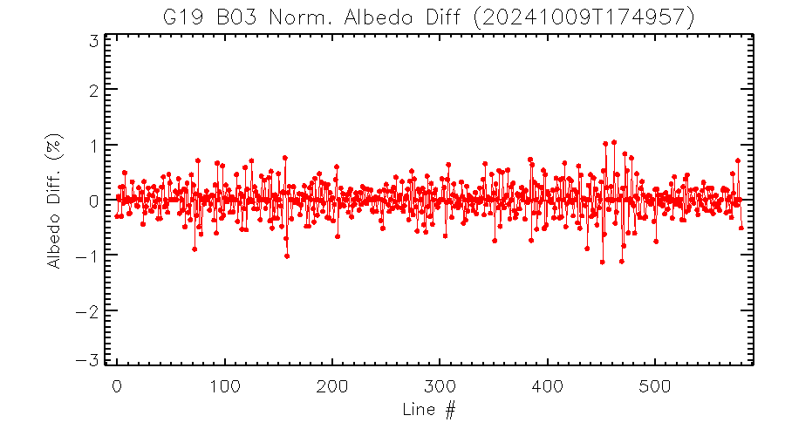
Band 3
stitch area line
Normalized albedo difference marginally exceeds 1% for only a few lines.

Slide 47
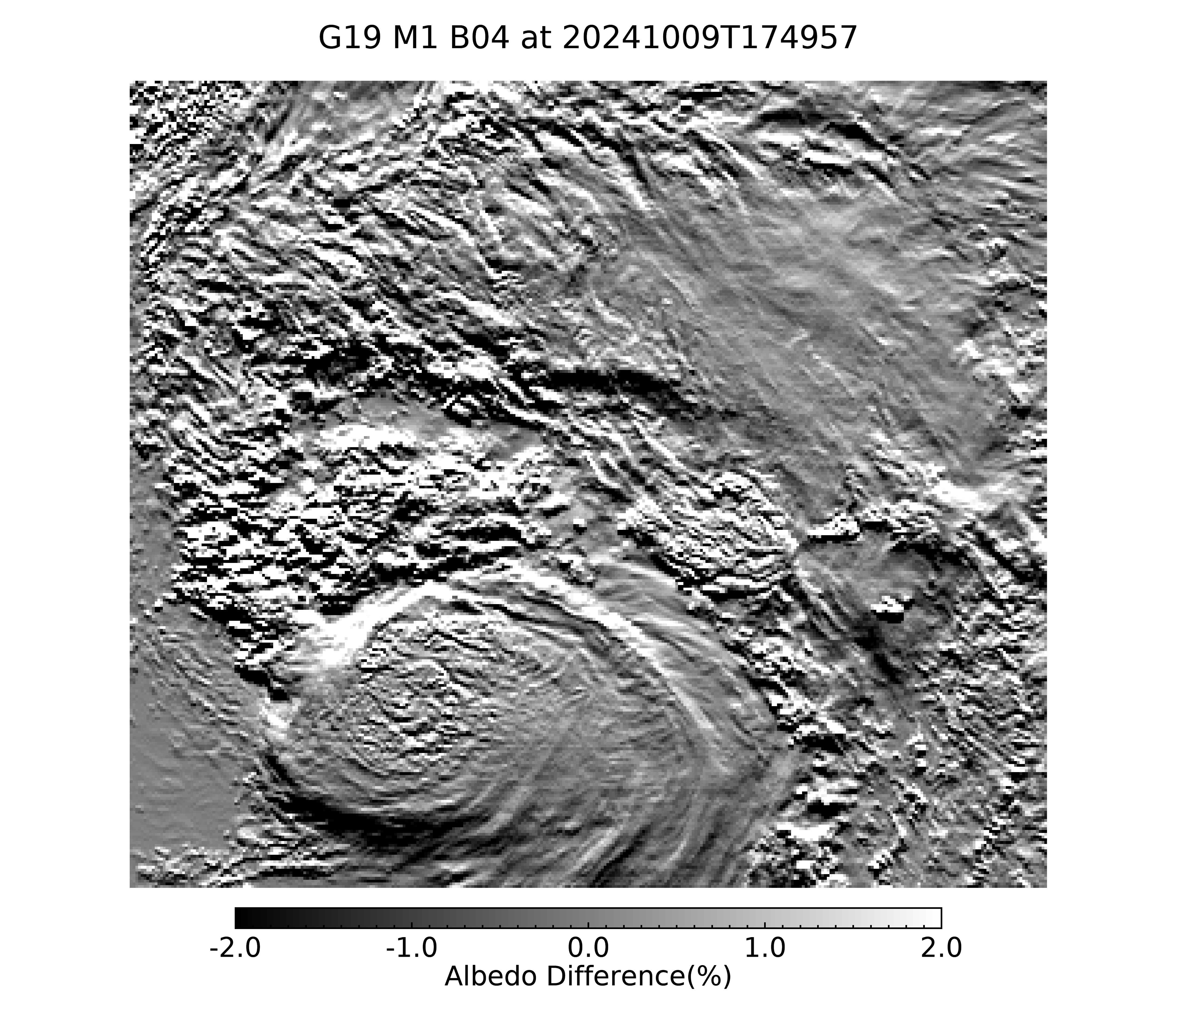
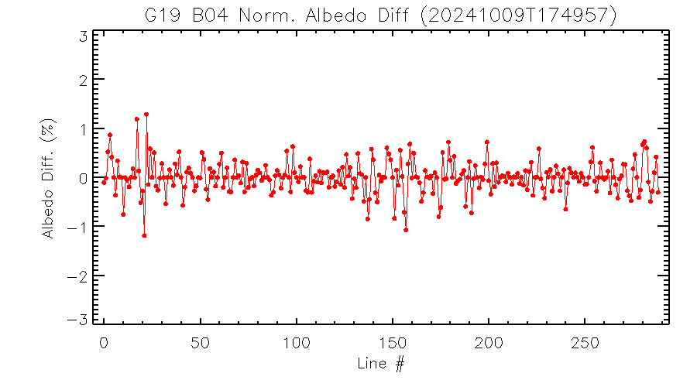
Band 4
Normalized albedo difference marginally exceeds 1% for only a few lines.

Slide 48
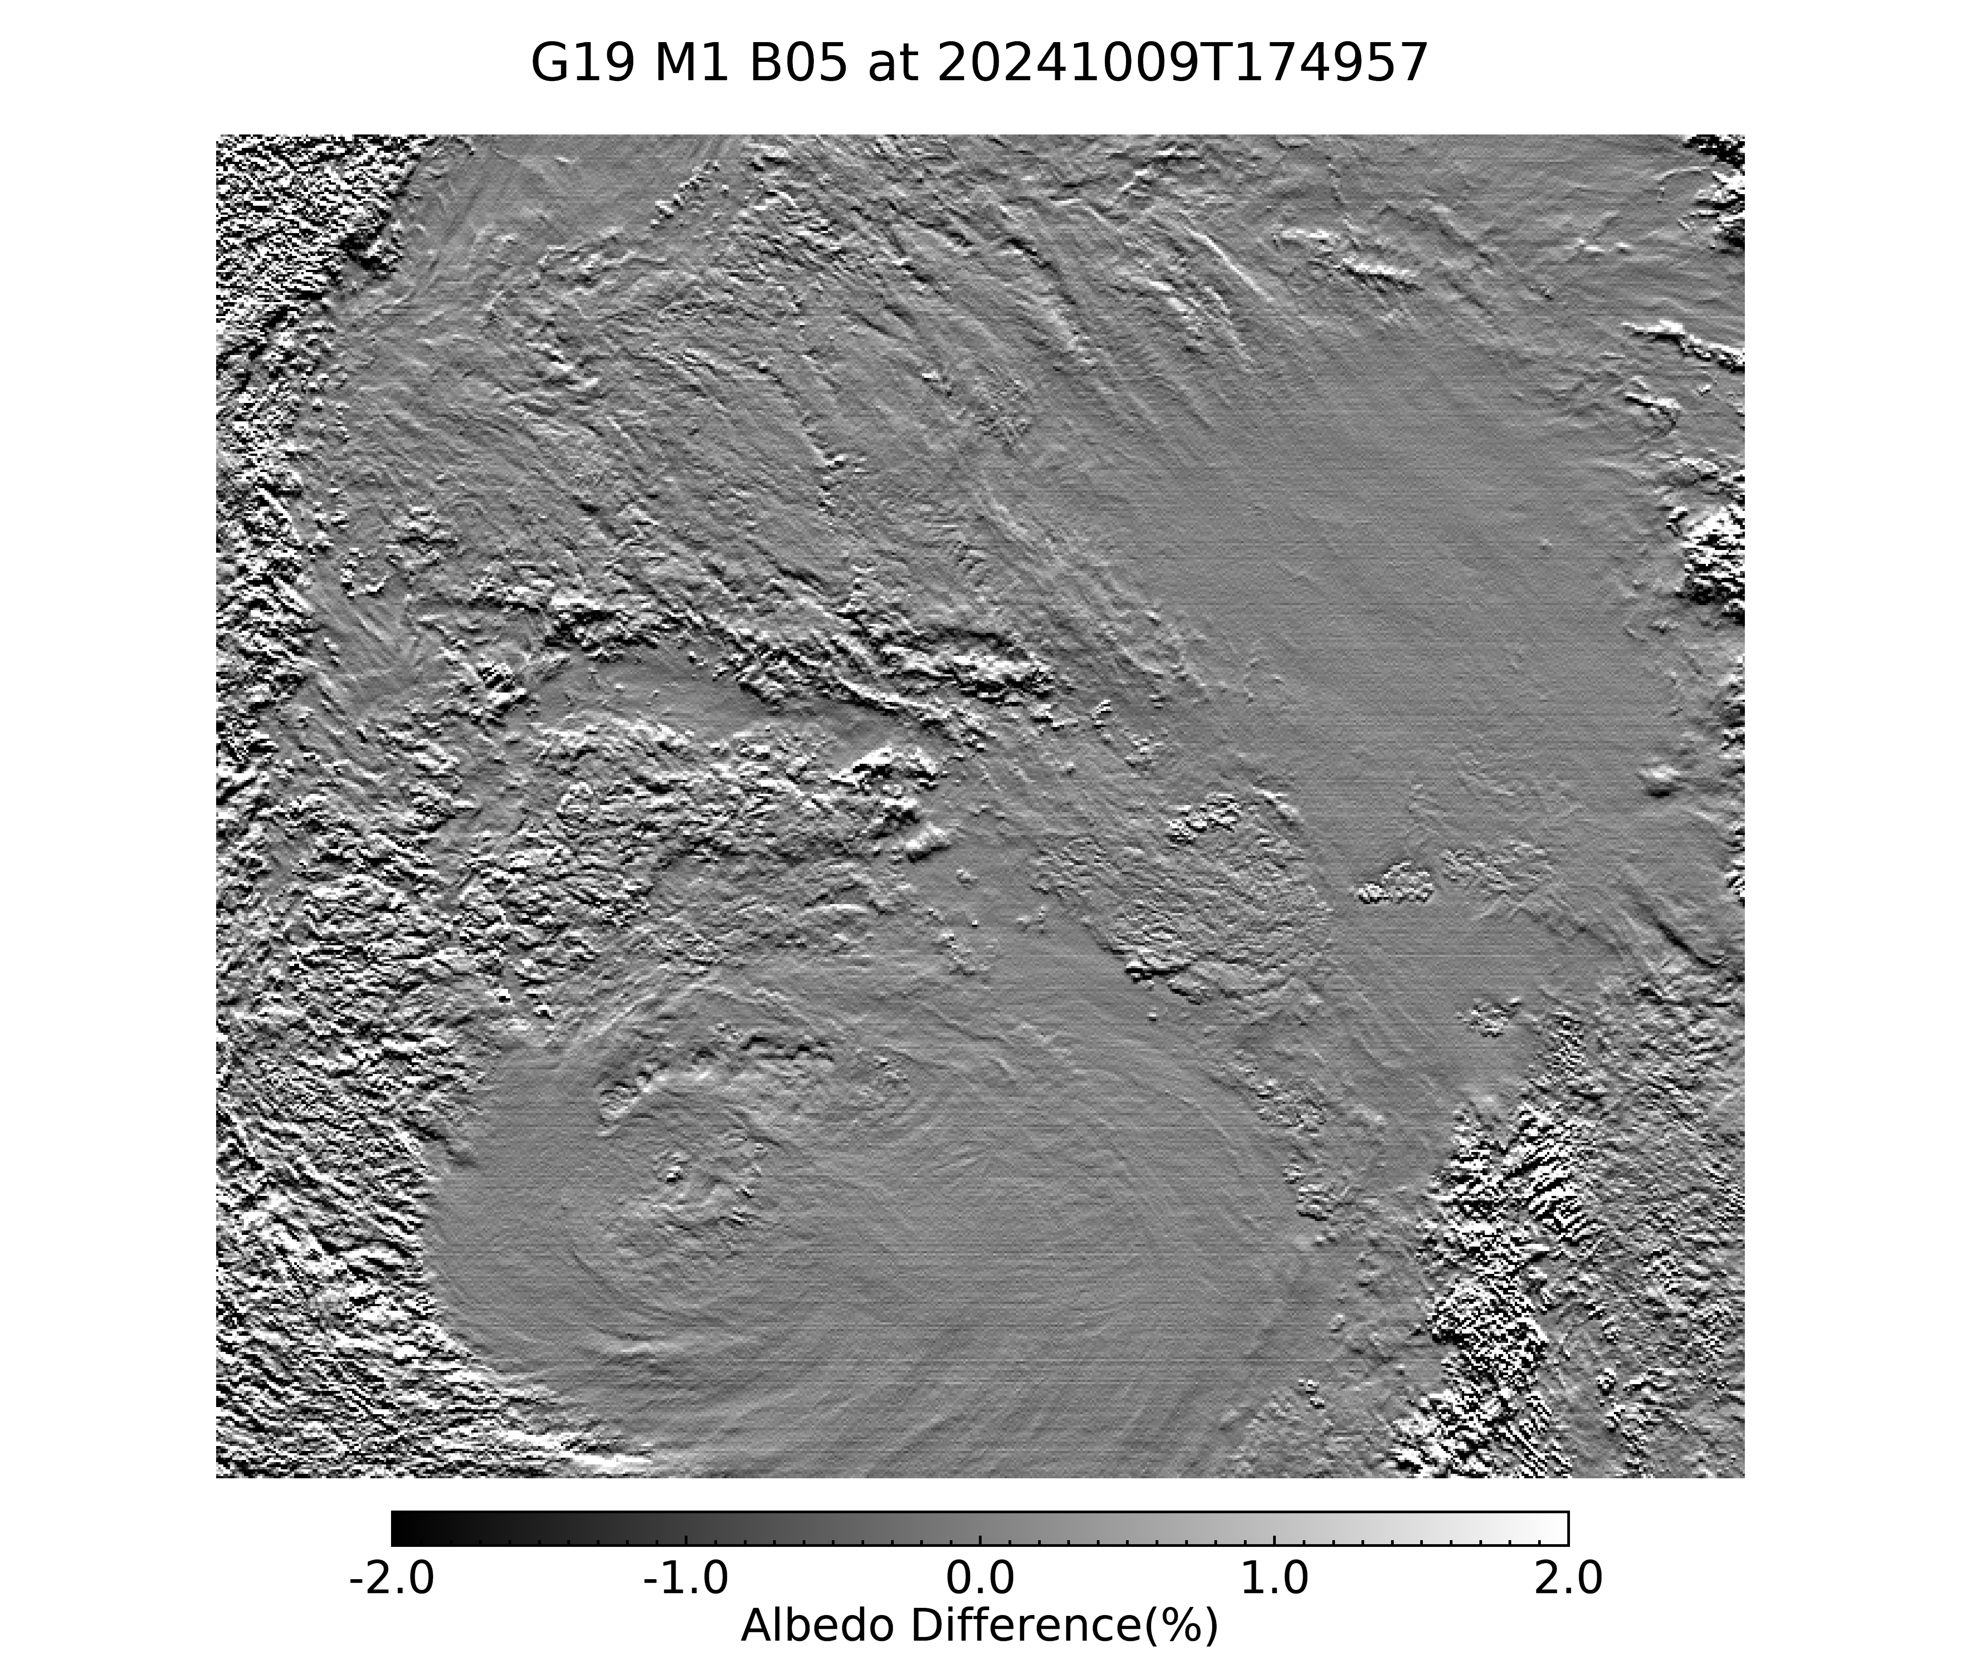
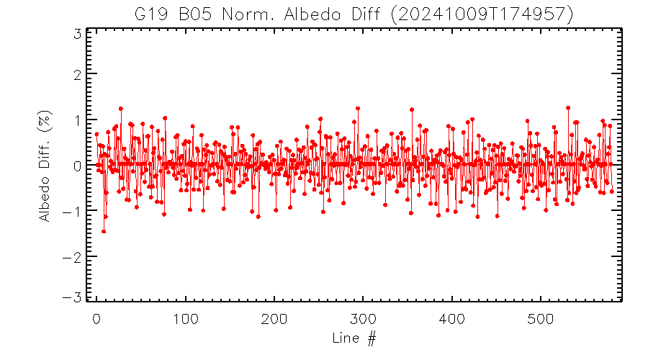
Band 5
Normalized albedo difference marginally exceeds 1% for some lines.

Slide 49
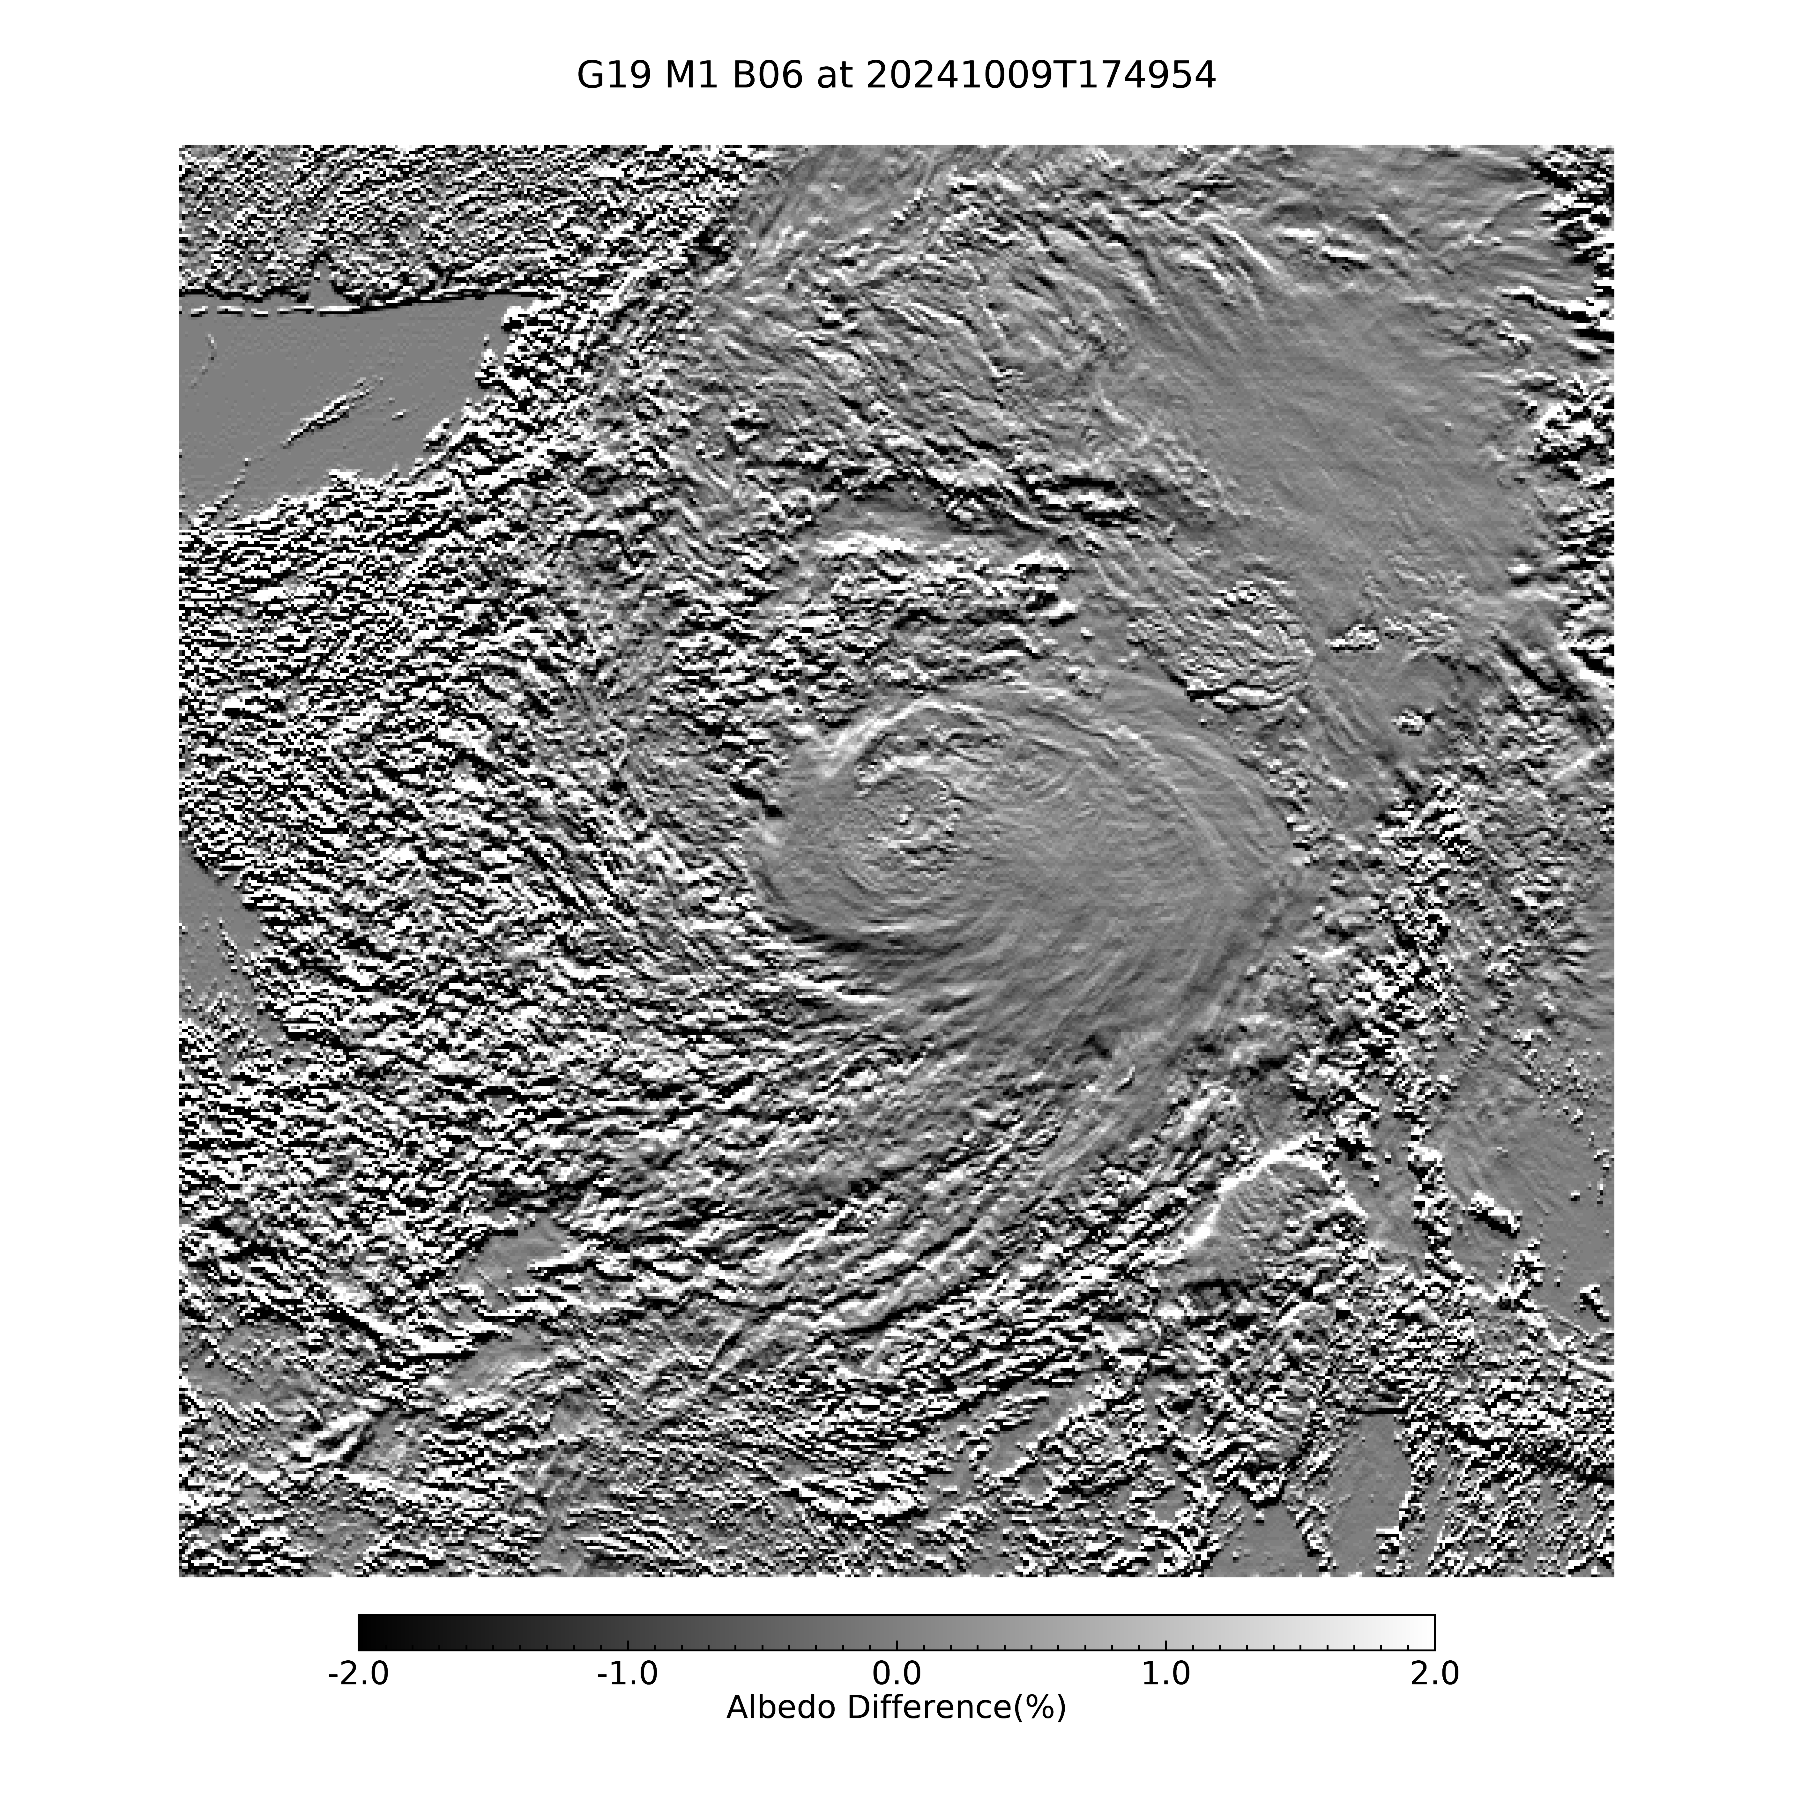
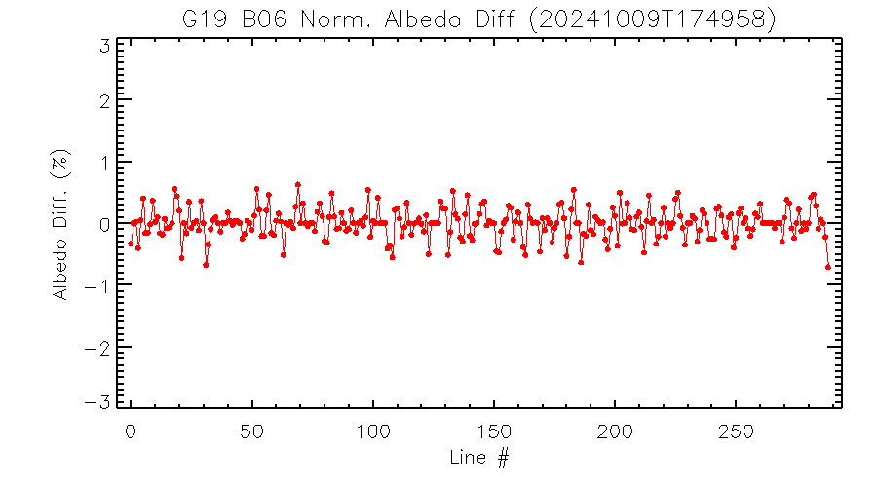
Band 6
Normalized albedo differences are well within 1% for all lines.

Slide 50
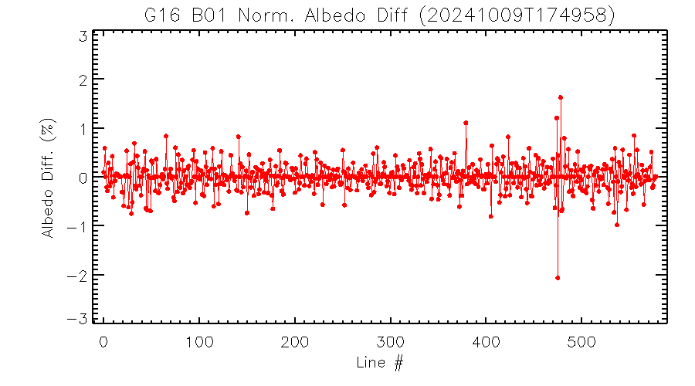
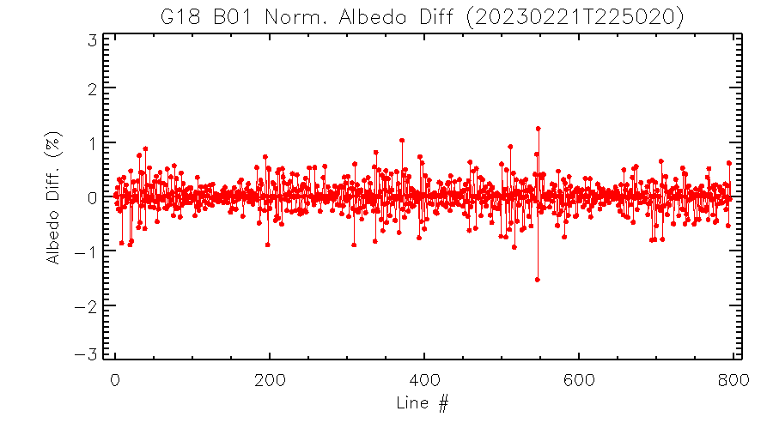
Comparison of G16/G18/G19 B01 Striping
N → S
N → S
G19 has the worst striping in terms of magnitude and frequency among the three ABIs.
N → S

Slide 51
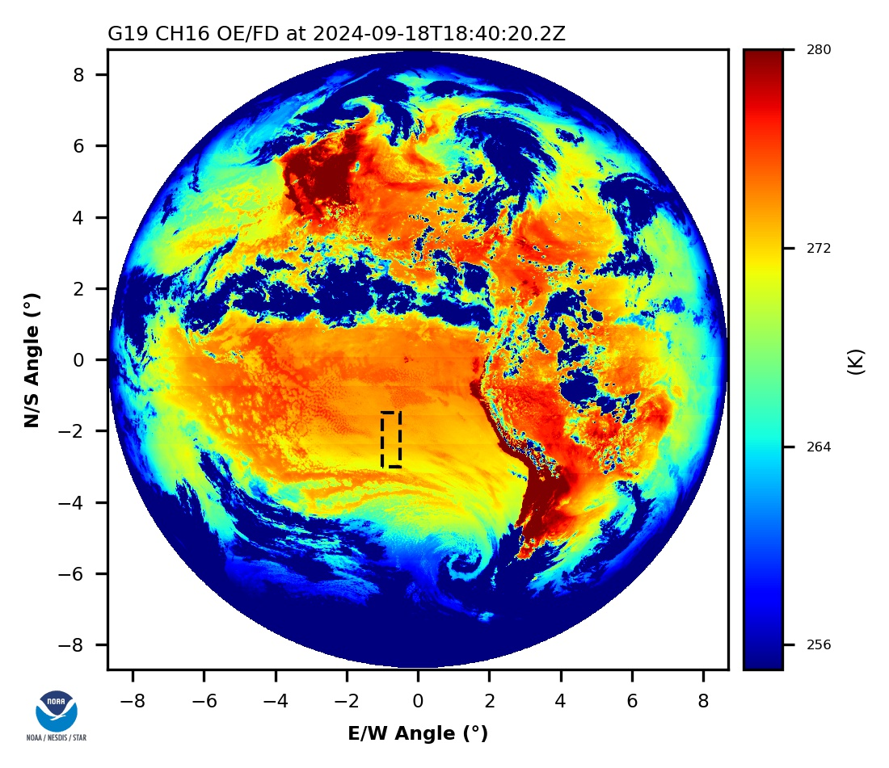
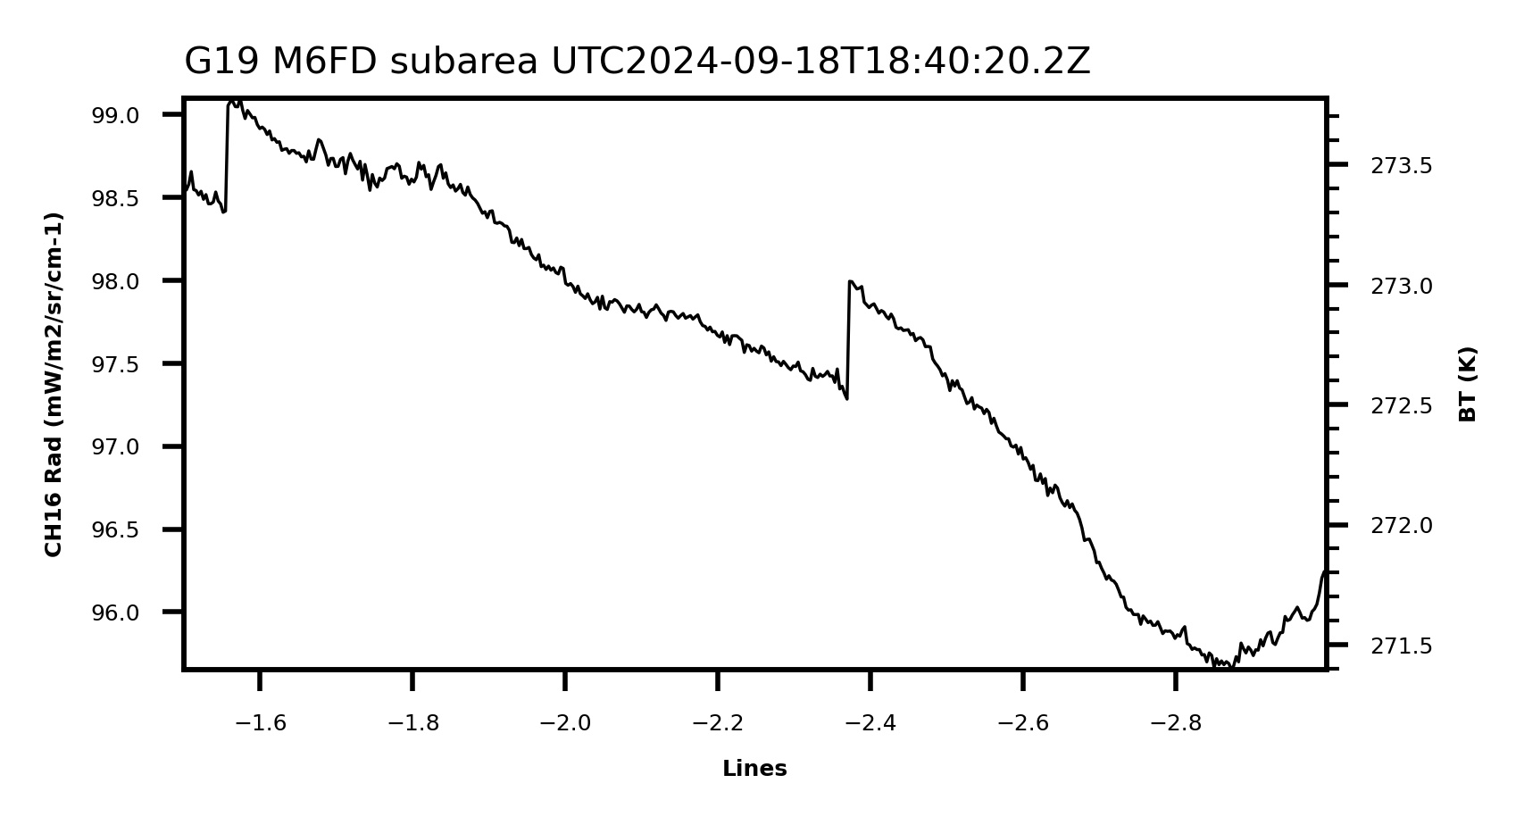
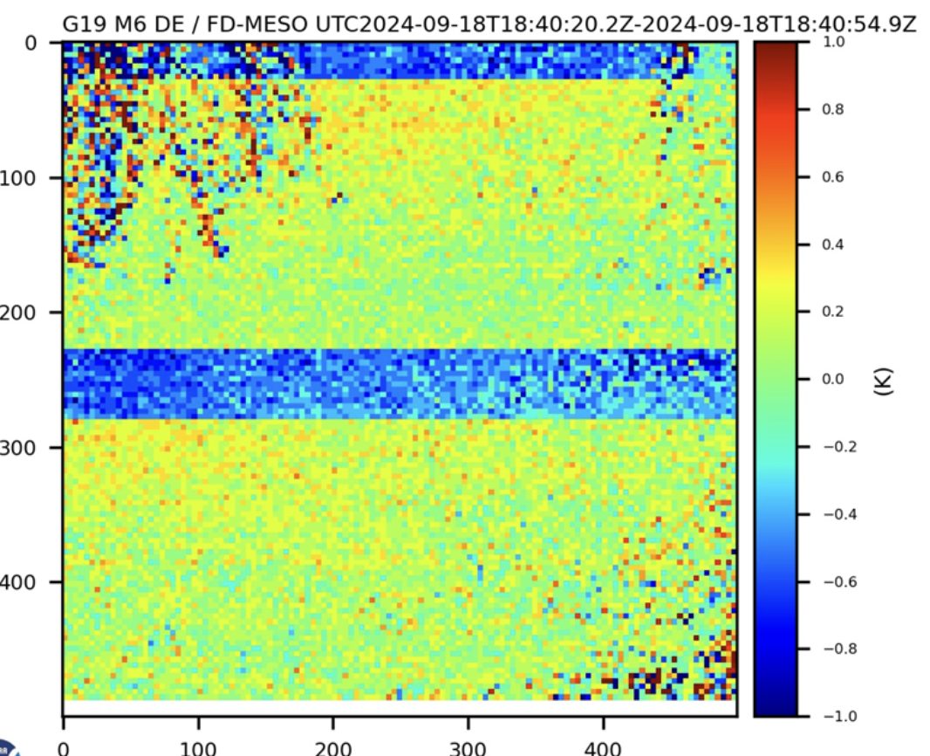
4) Banding at B16
Discontinuity along swath boundary in B16 image has been be detected.
  Radiance difference on the two sides of the stitching area can be up to that equivalent to T_{b} difference of 0.4 K @ 300 K.
When enhanced, they appear as bands along swath boundaries, hence the name.
Banding is likely caused by a semi-uniform change of detector spectral response function (SRF) across the FPA.
  Detectors senses temperature at progressively different levels of atmosphere across the FPA, creating discontinuity at boundary.
So far it is a potential threat. No documented impact yet.
This is being investigated under ADR1493.
References
  Xu et al., CWG meeting on 09/13/2024 and 09/27/2024
  Efremova et al., “Detector level ABI spectral response function: FM4 analysis and comparison to other ABI modules”, SPIE 2016

Slide 52
5) Channel 16 (13.3 µm) SRF Error
Recall that B16 (13.3 µm) bias is exceptionally large (-0.5 K) and significantly different from zero.

Slide 53
Infrared Channel Accuracy
B16 (13.3 µm) bias is exceptionally large (-0.5 K) and significantly different from zero.

Slide 54
5) Channel 16 (13.3 µm) SRF Error
Recall that B16 (13.3 µm) bias is exceptionally large (-0.5 K) and significantly different from zero.
The bias also depends on scene radiance, an indication that the root cause is likely due to SRF error.

Slide 55
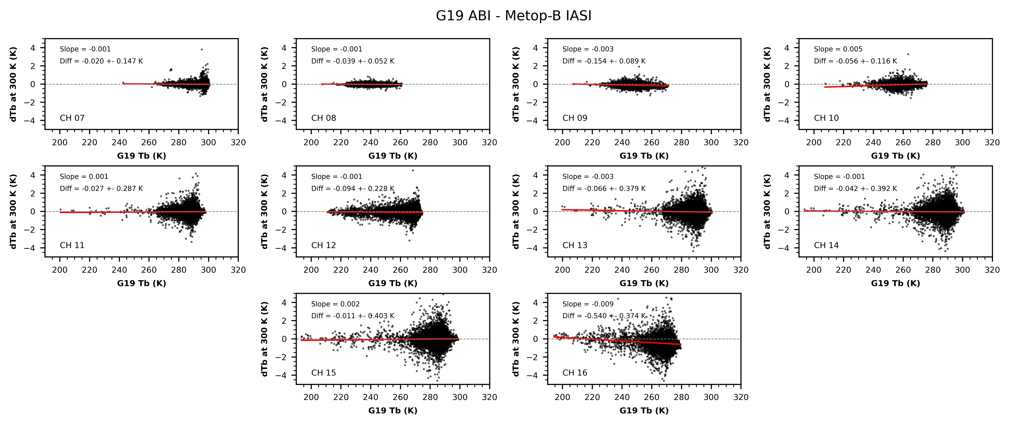
G19 ABI vs. Metop-B IASI
Biases are independent of radiance intensity except for Channel 16 (13.3 µm).

Slide 56

G19 ABI vs. Metop-C IASI
Biases are independent of radiance intensity except for Channel 16 (13.3 µm).

Slide 57

G19 ABI vs. NOAA-20 CrIS
Incomplete Spectral Coverage
Biases are independent of radiance intensity except for Channel 16 (13.3 µm).

Slide 58

G19 ABI vs. NOAA-21 CrIS
Incomplete Spectral Coverage
Biases are independent of radiance intensity except for Channel 16 (13.3 µm).

Slide 59
5) Channel 16 (13.3 µm) SRF Error
Recall that B16 (13.3 µm) bias is exceptionally large (-0.5 K) and significantly different from zero.
The bias also depends on scene radiance, an indication that the root cause is likely due to SRF error.
The relevant requirement is 1 K for accuracy, so strictly speaking the product meets the requirement.
However, this is a user need for requirement compliant product that we could help with:
  It affects many cloud products and wind height.
  We have encountered similar issues with previous GOES.

Slide 60
6) GOES-16/19 Difference
Recall that B01 biases are within 3% from references for both GOES-16 and GOES-19, however their biases have different signs.

Slide 61
ABI VNIR Accuracy at Provisional
PLPT-04
GOES-19 ABI VNIR accuracy is comparable to those on GOES-16/17/18 at Provisional.
Channel 2 calibration was adjusted to reduce the bias.

Slide 62
6) GOES-16/19 Difference
Recall that B01 biases are within 3% from references for both GOES-16 and GOES-19, however their biases have different signs.
That led to the situation that although both ABI products meet the requirement, they have a relatively large difference from each other.

Slide 63
Comparison
G19 is darker than G16
A definitive comparison is premature at this early stage.
A cursory inspection confirms that the initial calibration of GOES-19 ABI solar channels is not grossly out of family.

Slide 64
6) GOES-16/19 Difference
Recall that B01 biases are within 3% from references for both GOES-16 and GOES-19, however their biases have different signs.
That led to the situation that although both ABI products meet the requirement, they have a relatively large difference from each other.
Furthermore, that could happen to another channel, again with opposite sign.

Slide 65
Comparison
G19 is brighter than G16
G19 is darker than G16
A definitive comparison is premature at this early stage.
A cursory inspection confirms that the initial calibration of GOES-19 ABI solar channels is not grossly out of family.

Slide 66
6) GOES-16/19 Difference
Recall that B01 biases are within 3% from references for both GOES-16 and GOES-19, however their biases have different signs.
That led to the situation that although both ABI products meet the requirement, they have a relatively large difference from each other.
Furthermore, that could happen to another channel, again with opposite sign.
That amplifies the difference of products using channel differences, which is especially relevant since GOES-19 will replace GOES-16.

Slide 67

Time Series of AOD and AOD Bias
Product Developer:
  Aerosol Optical Depth (AOD) derived from ground measurements agree well with GOES-16 AOD (not shown) but not with GOES-19 AOD (left).
  Could GOES-19 B6 or B3 or B2 reflectances were biased high, and/or the B1 reflectance was biased low?
As we know, that is the case.
Once they adjusted for the relative differences …

Slide 68
Time Series of AOD and AOD Bias
Aerosol Optical Depth (AOD), derived from GOES-19 ABI and ground measurements, before (left) and after (right) bias correction.
This is another user need for requirement compliant product that we could help with.

Slide 69
Summary & assessment
Issues

Slide 70
Summary of Issues (1/3)
Moderate: Minor or moderate impact on applications. Similar precedence exists.
Unexplained trend in solar channel gain (ADR 1516).
  Alignment error is suspected.
Bad detector of B02 D682 (ADR 1484/1508/1511).
  BDS update and DRL are in progress.

Slide 71
Summary of Issues (2/3)
Minor: No or little impacts on applications. Root cause is known and mitigation is in progress.
Multiple weak striping in B01 images (ADR 1501)
  Worst for GOES-19 B01.
  May be improved with further optimization of nonlinearity coefficient Q.
B16 image banding (ADR 1493)
  Likely caused by a semi-uniform change of detector spectral response function (SRF) across the FPA.
    Unlikely to have an easy solution, though.
Channel 16 SRF error (ADR 1509)
  ~0.5 K and scene-dependent bias for B16 (13.3 µm)
  Likely due to incorrect spectral response function (SRF) for this channel.
Relative bias between GOES-16/19
  No requirement violation, but users can use our help.
  GSICS Harmonization is the right tool for this.

Slide 72
Summary of Issues (3/3)
Other Minor Issues (did not elaborate):
BDS update for B06 D363 (ADR 1520).
BDS update for B12 D026 (ADR 1526).
Update the K-LUT for B02 (ADR 1526).
Large cal-to-cal gain change for solar channels (HITL).
Quality control for Level shift (ADR 1519).

Slide 73
Maturity assessment

Slide 74
Provisional Maturity Criteria
Preparation Activities | Assessment
Validation activities are ongoing and the general research community is now encouraged to participate. | Product quality has been bench marked. Comprehensive validation activities are ongoing. The general research community has been actively participating and providing feedback.
Severe algorithm anomalies are identified and under analysis. Solutions to anomalies are in development and testing. | Product quality has been improved significantly since beta. No severe anomaly currently exists. Two moderate anomalies are being investigated.
Incremental product improvements may still be occurring. | Incremental product improvements are expected.

Slide 75
Provisional Maturity Criteria
End State | Assessment
Product performance has been demonstrated through analysis of a small number of independent measurements obtained from select locations, periods, and associated ground truth or field campaign efforts. | This has been demonstrated.
Product analysis is sufficient to communicate product performance to users relative to expectations (Performance Baseline). | Performance was communicated relative to Baseline for GOES-16 and existing ABI for GOES-7/18/19.
Documentation of product performance exists that includes recommended remediation strategies for all anomalies and weaknesses. Any algorithm changes associated with severe anomalies have been documented, implemented, tested, and shared with the user community. | Product performance has been documented in test reports and elsewhere. A summary for general users has been submitted for Beta Maturity and will be updated for Provisional Maturity.
Testing has been fully documented. | Testing has been fully documented in PLPT Report.
Product is ready for operational use and for use in comprehensive cal/val activities and product optimization. | We concur.

Slide 76
Path to Full Validation
Complete PLPTs.
Resolve current issues.
Monitor for new anomalies.
Prepare comprehensive assessment of instrument performance and L1b product quality for maturity promotion.
Identify and manage risks.

Slide 77
Summary and recommendations

Slide 78
Summary and Recommendations
Reviewed the Post-Launch Product Tests (PLPT) per RIMP.
Highlighted key performances of ABI L1b product.
  Included radiometric calibration of solar and infrared channels and Image Navigation and Registration.
  Demonstrated excellent accuracy and precision as compared to MRD, Baseline, and GOES-16/17/18 performance.
  Described status of on-going PLPTs.
  evaluated issues and their mitigation plans.
Assessed the Provisional Maturity per GOES-R Program
Outlined the path to Full Validation maturity.
Recommendation: The GOES-19 ABI L1b products be promoted to the Provisional Maturity per GOES-R Program.

